Slide 1
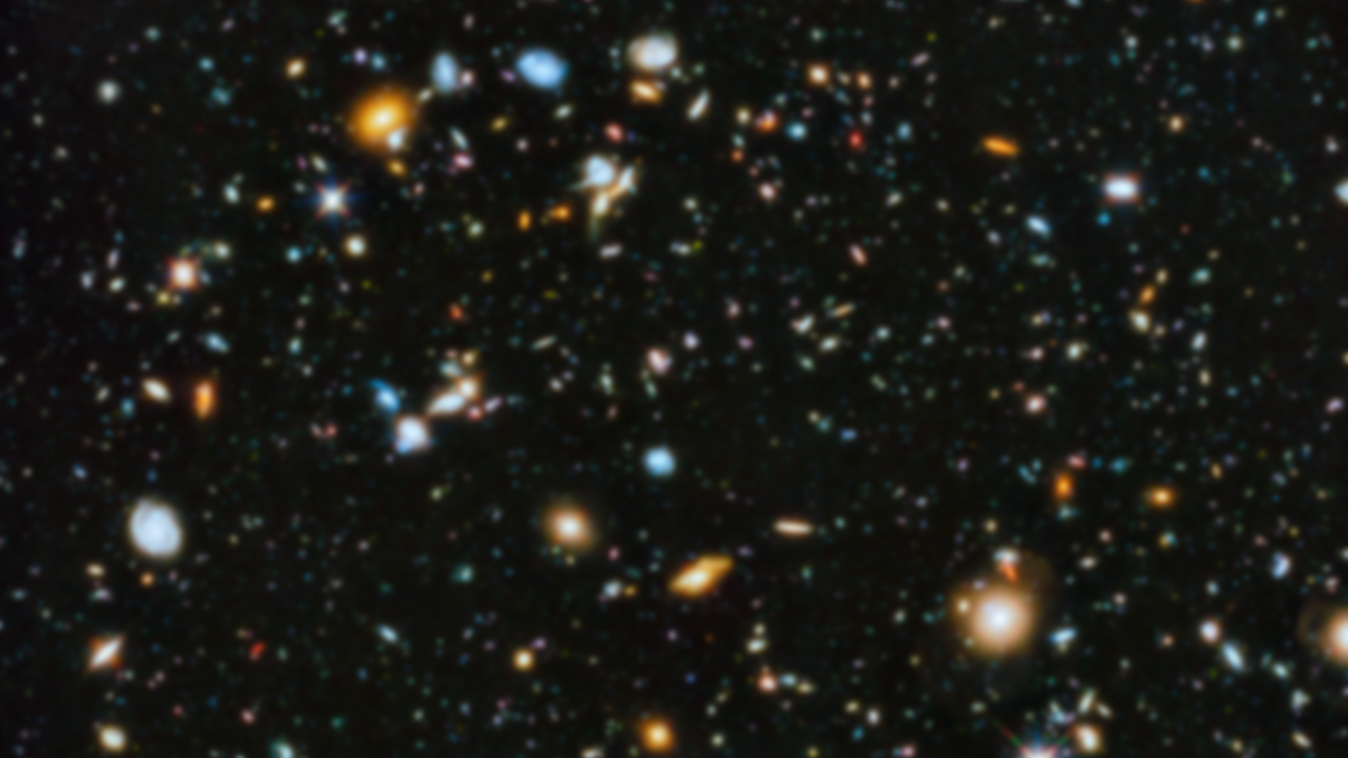
Common number systems

Slide 2
Binary | Base-2 | Radix-2
(0,1)₂

Slide 3
1 | 0 | 1 | 0 | 1 | 1 | 0 | 1

Slide 4
2⁷ | 2⁶ | 2⁵ | 2⁴ | 2³ | 2² | 2¹ | 2⁰
1 | 0 | 1 | 0 | 1 | 1 | 0 | 1

Slide 5
2⁷ | 2⁶ | 2⁵ | 2⁴ | 2³ | 2² | 2¹ | 2⁰
1 | 0 | 1 | 0 | 1 | 1 | 0 | 1
1×2⁷ | 0×2⁶ | 1×2⁵ | 0×2⁴ | 1×2³ | 1×2² | 0×2¹ | 1×2⁰
×

Slide 6
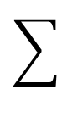
2⁷ | 2⁶ | 2⁵ | 2⁴ | 2³ | 2² | 2¹ | 2⁰
1 | 0 | 1 | 0 | 1 | 1 | 0 | 1
1×2⁷ | 0×2⁶ | 1×2⁵ | 0×2⁴ | 1×2³ | 1×2² | 0×2¹ | 1×2⁰
 |  |  |  |  |  |  |  | 173
×

Slide 7
2⁷ | 2⁶ | 2⁵ | 2⁴ | 2³ | 2² | 2¹ | 2⁰
3 | 0 | 3 | 0 | 2 | 1 | 3 | 1
 |  |  |  |  |  |  |  | -
×

Slide 8
2⁷ | 2⁶ | 2⁵ | 2⁴ | 2³ | 2² | 2¹ | 2⁰
3 | 0 | 3 | 0 | 2 | 1 | 3 | 1
- | 0×2⁶ | - | 0×2⁴ | - | 1×2² | - | 1×2⁰
 |  |  |  |  |  |  |  | Not Valid
×

Slide 9
Let’s count in binary
(░ ░ ░ ░)₂

Slide 10
Increment by 1 → Increment by 0001
+ Base-2 |  |  |  | 1 | 0 | 1 | 1
 |  |  |  | 0 | 0 | 0 | 1

Slide 11
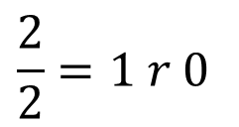
Increment by 1 → Increment by 0001
 |  |  |  |  |  | 1
+ Base-2 |  |  |  | 1 | 0 | 1 | 1
 |  |  |  | 0 | 0 | 0 | 1
 |  |  |  |  |  |  | 2→0
$$\frac{2}{2}=1 r 0$$

Slide 12
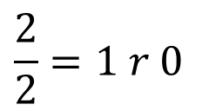
Increment by 1 → Increment by 0001
 |  |  |  |  | 1 | 1
+ Base-2 |  |  |  | 1 | 0 | 1 | 1
 |  |  |  | 0 | 0 | 0 | 1
 |  |  |  |  |  | 2→0 | 0
$$\frac{2}{2}=1 r 0$$

Slide 13
Increment by 1 → Increment by 0001
 |  |  |  |  | 1 | 1
+ Base-2 |  |  |  | 1 | 0 | 1 | 1
 |  |  |  | 0 | 0 | 0 | 1
 |  |  |  | 1 | 1 | 0 | 0

Slide 14
Octal | Base-8 | Radix-8
(0,1,2,3,4,5,6,7)₈

Slide 15
3 | 0 | 3 | 0 | 2 | 1 | 3 | 1
Notes:
0×8^9+ 0×8^8+ 3×8^7+ 3×8^6+ 3×8^5+ 3×8^8+ 2×8^3+ 1×8^2+ 3×8^1+ 1×8^0 =

Slide 16
8⁷ | 8⁶ | 8⁵ | 8⁴ | 8³ | 8² | 8¹ | 8⁰
3 | 0 | 3 | 0 | 2 | 1 | 3 | 1
Notes:
0×8^9+ 0×8^8+ 3×8^7+ 3×8^6+ 3×8^5+ 3×8^8+ 2×8^3+ 1×8^2+ 3×8^1+ 1×8^0 =

Slide 17
8⁷ | 8⁶ | 8⁵ | 8⁴ | 8³ | 8² | 8¹ | 8⁰
3 | 0 | 3 | 0 | 2 | 1 | 3 | 1
3×8⁷ | 0×8⁶ | 3×8⁵ | 0×8⁴ | 2×8³ | 1×8² | 3×8¹ | 1×8⁰
×
Notes:
0×8^9+ 0×8^8+ 3×8^7+ 3×8^6+ 3×8^5+ 3×8^8+ 2×8^3+ 1×8^2+ 3×8^1+ 1×8^0 =

Slide 18
8⁷ | 8⁶ | 8⁵ | 8⁴ | 8³ | 8² | 8¹ | 8⁰
3 | 0 | 3 | 0 | 2 | 1 | 3 | 1
3×8⁷ | 0×8⁶ | 3×8⁵ | 0×8⁴ | 2×8³ | 1×8² | 3×8¹ | 1×8⁰
 |  |  |  |  |  |  |  | 6,390,873
×
Notes:
3×8^7+ 0×8^6+ 3×8^5+ 0×8^4+ 2×8^3+ 1×8^2+ 3×8^1+ 1×8^0 =

Slide 19
8⁷ | 8⁶ | 8⁵ | 8⁴ | 8³ | 8² | 8¹ | 8⁰
3 | 0 | A | 0 | 8 | 1 | 3 | 1
×

Slide 20
8⁷ | 8⁶ | 8⁵ | 8⁴ | 8³ | 8² | 8¹ | 8⁰
3 | 0 | A | 0 | 8 | 1 | 3 | 1
3×8⁷ | 0×8⁶ | - | 0×8⁴ | - | 1×8² | 3×8¹ | 1×8⁰
 |  |  |  |  |  |  |  | Not Valid
×

Slide 21
8⁷ | 8⁶ | 8⁵ | 8⁴ | 8³ | 8² | 8¹ | 8⁰
1 | 0 | 1 | 0 | 1 | 1 | 0 | 1
1×8⁷ | 0×8⁶ | 1×8⁵ | 0×8⁴ | 1×8³ | 1×8² | 0×8¹ | 1×8⁰
 |  |  |  |  |  |  |  | 2,130,497
×

Slide 22
8⁷ | 8⁶ | 8⁵ | 8⁴ | 8³ | 8² | 8¹ | 8⁰
1 | 0 | 1 | 0 | 1 | 1 | 0 | 1
1×8⁷ | 0×8⁶ | 1×8⁵ | 0×8⁴ | 1×8³ | 1×8² | 0×8¹ | 1×8⁰
 |  |  |  |  |  |  |  | 2,130,497
Radix-8
vs.
Radix-2
2⁷ | 2⁶ | 2⁵ | 2⁴ | 2³ | 2² | 2¹ | 2⁰
1 | 0 | 1 | 0 | 1 | 1 | 0 | 1
1×2⁷ | 0×2⁶ | 1×2⁵ | 0×2⁴ | 1×2³ | 1×2² | 0×2¹ | 1×2⁰
 |  |  |  |  |  |  |  | 173

Slide 23
Let’s count in octal
(░ ░ ░ ░)₈

Slide 24
Increment by 1 → Increment by 0001
+ Base-8 |  |  |  | 5 | 2 | 7 | 7
 |  |  |  | 0 | 0 | 0 | 1

Slide 25
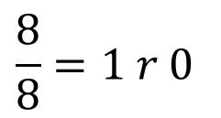
Increment by 1 → Increment by 0001
 |  |  |  |  |  | 1
+ Base-8 |  |  |  | 5 | 2 | 7 | 7
 |  |  |  | 0 | 0 | 0 | 1
 |  |  |  |  |  |  | 8→0
$$\frac{8}{8}=1 r 0$$

Slide 26
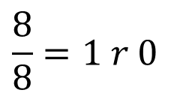
Increment by 1 → Increment by 0001
 |  |  |  |  | 1 | 1
+ Base-8 |  |  |  | 5 | 2 | 7 | 7
 |  |  |  | 0 | 0 | 0 | 1
 |  |  |  |  |  | 8→0 | 0
$$\frac{8}{8}=1 r 0$$

Slide 27
Increment by 1 → Increment by 0001
 |  |  |  |  | 1 | 1
+ Base-8 |  |  |  | 5 | 2 | 7 | 7
 |  |  |  | 0 | 0 | 0 | 1
 |  |  |  | 5 | 3 | 0 | 0

Slide 28
Decimal | Base-10 | Radix-10
(0,1,2,3,4,5,6,7,9)₁₀

Slide 29
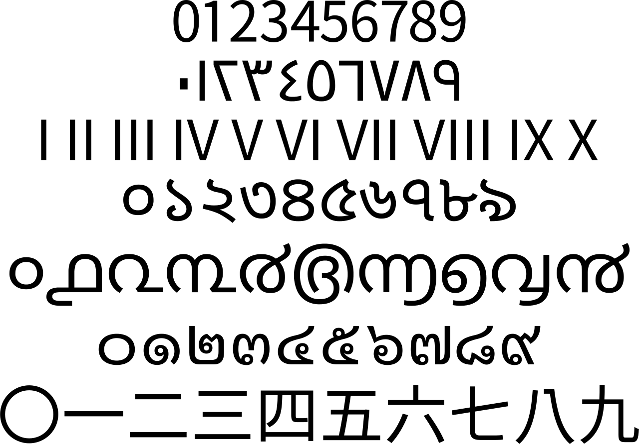
Notes:
Arabic numerals
Eastern Arabic numerals
Roman numerals (Roman numerals are a numeral system that originated in ancient Rome )
Bengali–Assamese numerals
Malayalam numerals
Thai numerals
Chinese numerals

Slide 30
3 | 0 | 3 | 0 | 2 | 1 | 3 | 1
Notes:
3×10^7+ 3×10^6+ 3×10^5+ 3×10^10+ 2×10^3+ 1×10^2+ 3×10^1+ 1×10^0 =

Slide 31
10⁷ | 10⁶ | 10⁵ | 10⁴ | 10³ | 10² | 10¹ | 10⁰
3 | 0 | 3 | 0 | 2 | 1 | 3 | 1
Notes:
3×10^7+ 3×10^6+ 3×10^5+ 3×10^10+ 2×10^3+ 1×10^2+ 3×10^1+ 1×10^0 =

Slide 32
10⁷ | 10⁶ | 10⁵ | 10⁴ | 10³ | 10² | 10¹ | 10⁰
3 | 0 | 3 | 0 | 2 | 1 | 3 | 1
3×10⁷ | 0×10⁶ | 3×10⁵ | 0×10⁴ | 2×10³ | 1×10² | 3×10¹ | 1×10⁰
×
Notes:
3×10^7+ 3×10^6+ 3×10^5+ 3×10^10+ 2×10^3+ 1×10^2+ 3×10^1+ 1×10^0 =

Slide 33
10⁷ | 10⁶ | 10⁵ | 10⁴ | 10³ | 10² | 10¹ | 10⁰
3 | 0 | 3 | 0 | 2 | 1 | 3 | 1
3×10⁷ | 0×10⁶ | 3×10⁵ | 0×10⁴ | 2×10³ | 1×10² | 3×10¹ | 1×10⁰
 |  |  |  |  |  |  |  | 30,302,131
×
Notes:
3×10^7+ 3×10^6+ 3×10^5+ 3×10^10+ 2×10^3+ 1×10^2+ 3×10^1+ 1×10^0 =

Slide 34
10⁷ | 10⁶ | 10⁵ | 10⁴ | 10³ | 10² | 10¹ | 10⁰
3 | 0 | 3 | 0 | 2 | 1 | 3 | 1
3×10⁷ | 0×10⁶ | 3×10⁵ | 0×10⁴ | 2×10³ | 1×10² | 3×10¹ | 1×10⁰
 |  |  |  |  |  |  |  | 30,302,131
×
Notes:
3×10^7+ 3×10^6+ 3×10^5+ 3×10^10+ 2×10^3+ 1×10^2+ 3×10^1+ 1×10^0 =

Slide 35
10⁷ | 10⁶ | 10⁵ | 10⁴ | 10³ | 10² | 10¹ | 10⁰
1 | 0 | 1 | 0 | 1 | 1 | 0 | 1
1×10⁷ | 0×10⁶ | 1×10⁵ | 0×10⁴ | 1×10³ | 1×10² | 0×10¹ | 1×10⁰
 |  |  |  |  |  |  |  | 10,101,101
×

Slide 36
10⁷ | 10⁶ | 10⁵ | 10⁴ | 10³ | 10² | 10¹ | 10⁰
1 | 0 | 1 | 0 | 1 | 1 | 0 | 1
1×10⁷ | 0×10⁶ | 1×10⁵ | 0×10⁴ | 1×10³ | 1×10² | 0×10¹ | 1×10⁰
 |  |  |  |  |  |  |  | 10,101,101
8⁷ | 8⁶ | 8⁵ | 8⁴ | 8³ | 8² | 8¹ | 8⁰
1 | 0 | 1 | 0 | 1 | 1 | 0 | 1
1×8⁷ | 0×8⁶ | 1×8⁵ | 0×8⁴ | 1×8³ | 1×8² | 0×8¹ | 1×8⁰
 |  |  |  |  |  |  |  | 2,130,497
2⁷ | 2⁶ | 2⁵ | 2⁴ | 2³ | 2² | 2¹ | 2⁰
1 | 0 | 1 | 0 | 1 | 1 | 0 | 1
1×2⁷ | 0×2⁶ | 1×2⁵ | 0×2⁴ | 1×2³ | 1×2² | 0×2¹ | 1×2⁰
 |  |  |  |  |  |  |  | 173

Slide 37
10⁷ | 10⁶ | 10⁵ | 10⁴ | 10³ | 10² | 10¹ | 10⁰
3 | 0 | A | 0 | 8 | 1 | 3 | 1
×

Slide 38
10⁷ | 10⁶ | 10⁵ | 10⁴ | 10³ | 10² | 10¹ | 10⁰
3 | 0 | A | 0 | 8 | 1 | 3 | 1
3×10⁷ | 0×10⁶ | - | 0×10⁴ | 8×10³ | 1×10² | 3×10¹ | 1×10⁰
 |  |  |  |  |  |  |  | Not Valid
×

Slide 39
you know how to count in decimal!
(░ ░ ░ ░)₁₀

Slide 40
Hexadecimal | Base-16 | Radix-16
(0,1,2,3,4,5,6,7,9,A,B,C,D,E,F)₁₆

Slide 41
16⁷ | 16⁶ | 16⁵ | 16⁴ | 16³ | 16² | 16¹ | 16⁰
3 | 0 | A | 0 | 9 | 1 | 3 | 1
×
Notes:
(30302131)₁₆ = (3 × 16⁷) + (0 × 16⁶) + (3 × 16⁵) + (0 × 16⁴) + (2 × 16³) + (1 × 16²) + (3 × 16¹) + (1 × 16⁰) = (808460593)₁₀

Slide 42
16⁷ | 16⁶ | 16⁵ | 16⁴ | 16³ | 16² | 16¹ | 16⁰
3 | 0 | A | 0 | 9 | 1 | 3 | 1
3×16⁷ | 0×16⁶ | A×16⁵ | 0×16⁴ | 9×16³ | 1×16² | 3×16¹ | 1×16⁰
×
Notes:
0×16^9+ 0×16^16+ 3×16^7+ 3×16^6+ 10×16^5+ 3×16^16+ 9×16^3+ 1×16^2+ 3×16^1+ 1×16^0 =

Slide 43
16⁷ | 16⁶ | 16⁵ | 16⁴ | 16³ | 16² | 16¹ | 16⁰
3 | 0 | A | 0 | 9 | 1 | 3 | 1
3×16⁷ | 0×16⁶ | A×16⁵ | 0×16⁴ | 9×16³ | 1×16² | 3×16¹ | 1×16⁰
×
A = (9 + 1) = (10)₁₀
Notes:
0×16^9+ 0×16^16+ 3×16^7+ 3×16^6+ 10×16^5+ 3×16^16+ 9×16^3+ 1×16^2+ 3×16^1+ 1×16^0 =

Slide 44
16⁷ | 16⁶ | 16⁵ | 16⁴ | 16³ | 16² | 16¹ | 16⁰
3 | 0 | A | 0 | 9 | 1 | 3 | 1
3×16⁷ | 0×16⁶ | A×16⁵ | 0×16⁴ | 9×16³ | 1×16² | 3×16¹ | 1×16⁰
 |  |  |  |  |  |  |  | 815,829,297
×
A = (9 + 1) = (10)₁₀
Notes:
(30A09131)₁₆ = (3 × 16⁷) + (0 × 16⁶) + (10 × 16⁵) + (0 × 16⁴) + (9 × 16³) + (1 × 16²) + (3 × 16¹) + (1 × 16⁰) = (815829297)₁₀

Slide 45
1,2,3,4,5,6,7,8,9,A
1,2,3,4,5,6,7,8,9,B
1,2,3,4,5,6,7,8,9,C
1,2,3,4,5,6,7,8,9,D
1,2,3,4,5,6,7,8,9,E
1,2,3,4,5,6,7,8,9,F
= 9 + 1
= A + 1
= B + 1
= C + 1
= D + 1
= E + 1
= (10)₁₀
= (11)₁₀
= (12)₁₀
= (13)₁₀
= (14)₁₀
= (15)₁₀

Slide 46
16⁷ | 16⁶ | 16⁵ | 16⁴ | 16³ | 16² | 16¹ | 16⁰
1 | 0 | 1 | 0 | 1 | 1 | 0 | 1
1×16⁷ | 0×16⁶ | 1×16⁵ | 0×16⁴ | 1×16³ | 1×16² | 0×16¹ | 1×16⁰
 |  |  |  |  |  |  |  | 269,488,385
×

Slide 47
16⁷ | 16⁶ | 16⁵ | 16⁴ | 16³ | 16² | 16¹ | 16⁰
1 | 0 | 1 | 0 | 1 | 1 | 0 | 1
1×16⁷ | 0×16⁶ | 1×16⁵ | 0×16⁴ | 1×16³ | 1×16² | 0×16¹ | 1×16⁰
 |  |  |  |  |  |  |  | 269,488,385
10⁷ | 10⁶ | 10⁵ | 10⁴ | 10³ | 10² | 10¹ | 10⁰
1 | 0 | 1 | 0 | 1 | 1 | 0 | 1
1×10⁷ | 0×10⁶ | 1×10⁵ | 0×10⁴ | 1×10³ | 1×10² | 0×10¹ | 1×10⁰
 |  |  |  |  |  |  |  | 10,101,101
8⁷ | 8⁶ | 8⁵ | 8⁴ | 8³ | 8² | 8¹ | 8⁰
1 | 0 | 1 | 0 | 1 | 1 | 0 | 1
1×8⁷ | 0×8⁶ | 1×8⁵ | 0×8⁴ | 1×8³ | 1×8² | 0×8¹ | 1×8⁰
 |  |  |  |  |  |  |  | 2,130,497
2⁷ | 2⁶ | 2⁵ | 2⁴ | 2³ | 2² | 2¹ | 2⁰
1 | 0 | 1 | 0 | 1 | 1 | 0 | 1
1×2⁷ | 0×2⁶ | 1×2⁵ | 0×2⁴ | 1×2³ | 1×2² | 0×2¹ | 1×2⁰
 |  |  |  |  |  |  |  | 173
Notes:
Add a diagram to show the growth

Slide 48
Let’s count in base-16
(░ ░ ░ ░)₁₆

Slide 49
Increment by 1 → Increment by 0001
+ Base-16 |  |  |  | 5 | C | A | F
 |  |  |  | 0 | 0 | 0 | 1

Slide 50
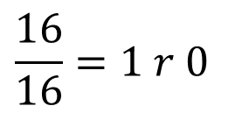
Increment by 1 → Increment by 0001
 |  |  |  |  |  | 1
+ Base-16 |  |  |  | 5 | C | A | F=15
 |  |  |  | 0 | 0 | 0 | 1
 |  |  |  |  |  |  | 16→0
$$\frac{16}{16}=1 r 0$$

Slide 51
Increment by 1 → Increment by 0001
 |  |  |  |  |  | 1
+ Base-16 |  |  |  | 5 | C | A=10 | F=15
 |  |  |  | 0 | 0 | 0 | 1
 |  |  |  |  |  | 11→B | 0

Slide 52
Increment by 1 → Increment by 0001
 |  |  |  |  |  | 1
+ Base-16 |  |  |  | 5 | C | A=10 | F=15
 |  |  |  | 0 | 0 | 0 | 1
 |  |  |  | 5 | C | B | 0

Slide 53
Base-64 | Radix-64
(A,B,C, …,Z, a,b,c,…,z,0,1,2,…,9,+,/)₆₄
1992: RFC 1341
MIME (Multipurpose Internet Mail Extensions)
Mechanisms For Specifying And Describing The Format Of Internet Message Bodies

Slide 54
Digit | Value | → | Digit | Value | → | Digit | Value | → | Digit | Value
A | 0 |  | Q | 16 |  | g | 32 |  | w | 48
B | 1 |  | R | 17 |  | h | 33 |  | x | 49
C | 2 |  | S | 18 |  | i | 34 |  | y | 50
D | 3 |  | T | 19 |  | j | 35 |  | z | 51
E | 4 |  | U | 20 |  | k | 36 |  | 0 | 52
F | 5 |  | V | 21 |  | l | 37 |  | 1 | 53
G | 6 |  | W | 22 |  | m | 38 |  | 2 | 54
H | 7 |  | X | 23 |  | n | 39 |  | 3 | 55
I | 8 |  | Y | 24 |  | o | 40 |  | 4 | 56
J | 9 |  | Z | 25 |  | p | 41 |  | 5 | 57
K | 10 |  | a | 26 |  | q | 42 |  | 6 | 58
L | 11 |  | b | 27 |  | r | 43 |  | 7 | 59
M | 12 |  | c | 28 |  | s | 44 |  | 8 | 60
N | 13 |  | d | 29 |  | t | 45 |  | 9 | 61
O | 14 |  | e | 30 |  | u | 46 |  | + | 62
P | 15 |  | f | 31 |  | v | 47 |  | / | 63

Slide 55
3 | a | A | / | d | 1 | H | +

Slide 56
64⁷ | 64⁶ | 64⁵ | 64⁴ | 64³ | 64² | 64¹ | 64⁰
3 | a | A | / | d | 1 | H | +
×

Slide 57
Digit | Value | → | Digit | Value | → | Digit | Value | → | Digit | Value
A | 0 |  | Q | 16 |  | g | 32 |  | w | 48
B | 1 |  | R | 17 |  | h | 33 |  | x | 49
C | 2 |  | S | 18 |  | i | 34 |  | y | 50
D | 3 |  | T | 19 |  | j | 35 |  | z | 51
E | 4 |  | U | 20 |  | k | 36 |  | 0 | 52
F | 5 |  | V | 21 |  | l | 37 |  | 1 | 53
G | 6 |  | W | 22 |  | m | 38 |  | 2 | 54
H | 7 |  | X | 23 |  | n | 39 |  | 3 | 55
I | 8 |  | Y | 24 |  | o | 40 |  | 4 | 56
J | 9 |  | Z | 25 |  | p | 41 |  | 5 | 57
K | 10 |  | a | 26 |  | q | 42 |  | 6 | 58
L | 11 |  | b | 27 |  | r | 43 |  | 7 | 59
M | 12 |  | c | 28 |  | s | 44 |  | 8 | 60
N | 13 |  | d | 29 |  | t | 45 |  | 9 | 61
O | 14 |  | e | 30 |  | u | 46 |  | + | 62
P | 15 |  | f | 31 |  | v | 47 |  | / | 63

Slide 58
64⁷ | 64⁶ | 64⁵ | 64⁴ | 64³ | 64² | 64¹ | 64⁰
3 | a | A | / | d | 1 | H | +
55 ×64⁷ | 26 ×64⁶ | 0 ×64⁵ | 63 ×64⁴ | 29 ×64³ | 53 ×64² | 7 ×64¹ | 62 ×64⁰
×

Slide 59
64⁷ | 64⁶ | 64⁵ | 64⁴ | 64³ | 64² | 64¹ | 64⁰
3 | a | A | / | d | 1 | H | +
55 ×64⁷ | 26 ×64⁶ | 0 ×64⁵ | 63 ×64⁴ | 29 ×64³ | 53 ×64² | 7 ×64¹ | 62 ×64⁰
 |  |  |  |  |  |  |  | 243,680,329,290,238
×
Notes:
55*64^7+26*64^6+0*64^5+63*64^4+29*64^3+53*64^2+7*64^1+62*64^0

Slide 60
Let’s count in base-64
(░ ░ ░ ░)₆₄

Slide 61
Increment by 1 → Increment by AAAB
+ Base-64 |  |  |  | a | + | Z | /
 |  |  |  | A=0 | A=0 | A=0 | B=1

Slide 62
Increment by 1 → Increment by AAAB
+ Base-64 |  |  |  | a=26 | +=62 | Z=25 | /=63
 |  |  |  | A=0 | A=0 | A=0 | B=1

Slide 63
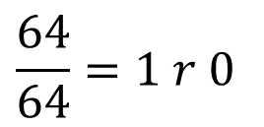
 |  |  |  |  |  | B=1
+ Base-64 |  |  |  | a=26 | +=62 | Z=25 | /=63
 |  |  |  | A=0 | A=0 | A=0 | B=1
 |  |  |  |  |  |  | A=0
$$\frac{64}{64}=1 r 0$$

Slide 64
 |  |  |  |  |  | B=1
+ Base-64 |  |  |  | a=26 | +=62 | Z=25 | /=63
 |  |  |  | A=0 | A=0 | A=0 | B=1
 |  |  |  | a | + | a=26 | A=0

Slide 65
Radix-r number system
aka. Base-r Number System
Hossein’s number system is not a Radix-r number system!

Slide 66
Let (N)_{r} be a radix-r (base-r) number in a positional weighting number system, then
(N)_{r} = (d_{n-1} r^{n-1} + d_{n-2} r^{n-2} + ... + d_{i} r^{i} + ... + d₂ r² + d₁ r¹ + d₀r⁰)₁₀
where:
r = radix (base)
d_{i} = digit at position i, 0 ≤ d_{i} ≤ r - 1
r^{i} = weight (significance) of position i
n = number of digits in N

Slide 67
Let (N)_{r} be a radix-r (base-r) number in a positional weighting number system, then
(N)_{r} = (d_{n-1} r^{n-1} + d_{n-2} r^{n-2} + ... + d_{i} r^{i} + ... + d₂ r² + d₁ r¹ + d₀r⁰)₁₀
where:
r = radix (base)
d_{i} = digit at position i, 0 ≤ d_{i} ≤ r - 1
r^{i} = weight (significance) of position i
n = number of digits in N

Slide 68
Let (N)_{r} be a radix-r (base-r) number in a positional weighting number system, then
Min = (0_{n-1}0_{n-2} ... 0₁0₀)_{r} = (0)₁₀
Max = ((r-1)_{n-1}(r-1)_{n-2} ... (r-1)₁(r-1)₀)_{r} = (r^{n}-1)₁₀
Unit = (0_{n-1}0_{n-2} ... 0₁1₀)_{r} = (1)₁₀
where:
r = radix (base)
r^{i} = weight of position i
n = number of digits in N

Slide 69
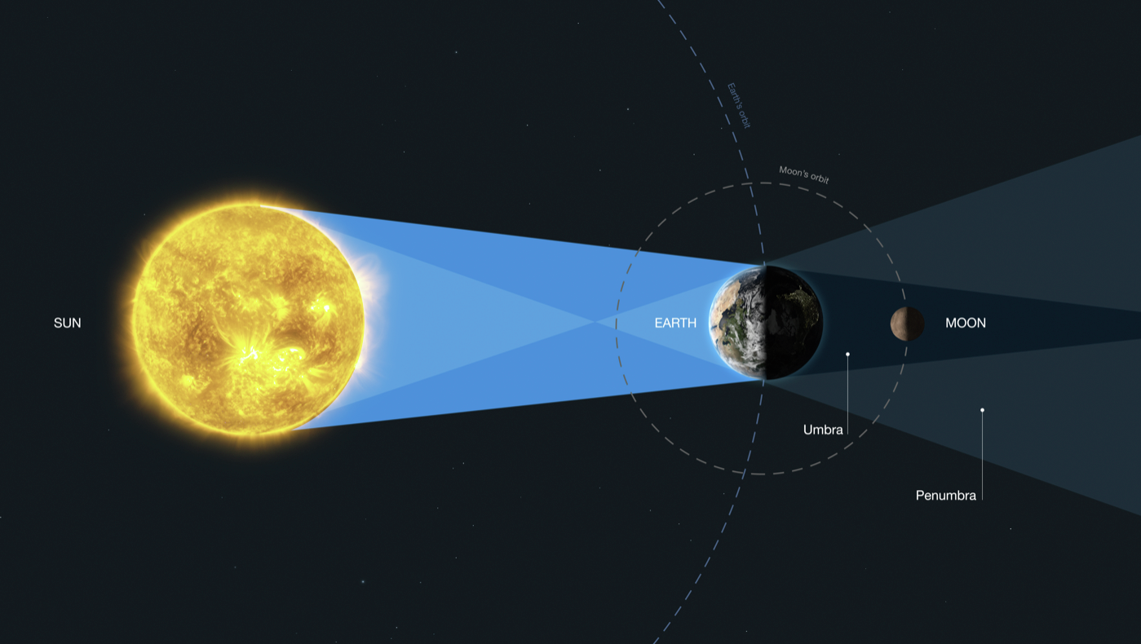
Moon’s Distance to Sun: (10.?)₄ = (4.5)₁₀
Notes:
Earth’s 12,742 km

Slide 70
Fraction

Slide 71
1 Earth
Moon’s Distance to Sun
Notes:
Earth’s 12,742 km

Slide 72
Fraction Point
Radix-4 (Base-4) = 1/4 Earth = 4⁻¹ Earth = (.1)₄
Moon’s Distance to Sun
Notes:
Earth’s 12,742 km

Slide 73
Radix-4 (Base-4) = 2 × 1/4 Earth = 2 × 4⁻¹ Earth=(.2)₄
Moon’s Distance to Sun
Notes:
Earth’s 12,742 km

Slide 74
Radix-4 (Base-4) = 3 × 1/4 Earth = 3 × 4⁻¹ Earth=(.3)₄
Moon’s Distance to Sun
Notes:
Earth’s 12,742 km

Slide 75
Radix-4 (Base-4) = 4 × 1/4 Earth = 4 × 4⁻¹ Earth=(1)₄
Moon’s Distance to Sun
Notes:
Earth’s 12,742 km

Slide 76
(10)₄
(3)₄
(2)₄
(1)₄
1/4
1/4
0
Moon’s Distance to Sun in Radix-4: (10 . 2)₄
Notes:
Earth’s 12,742 km

Slide 77
More precision

Slide 78
Radix-4 (Base-4) = 1/4 Earth = 4⁻¹ Earth = (.1)₄
Moon’s Distance to Sun
Notes:
Earth’s 12,742 km

Slide 79
Radix-4 (Base-4) = (1/4)/4 Earth = 1/16 Earth = 4⁻² Earth
Moon’s Distance to Sun
Notes:
Earth’s 12,742 km

Slide 80
Radix-4 (Base-4) = 1/16 = 4⁻² Earth = (.01)₄
Moon’s Distance to Sun
Notes:
Earth’s 12,742 km

Slide 81
Radix-4 (Base-4) = 2 × 1/16 = 2 × 4⁻² Earth = (.02)₄
Moon’s Distance to Sun
Notes:
Earth’s 12,742 km

Slide 82
Radix-4 (Base-4) = 3 × 1/16 = 3 × 4⁻² Earth = (.03)₄
Moon’s Distance to Sun
Notes:
Earth’s 12,742 km

Slide 83
Radix-4 (Base-4) = 4 × 1/16 = 4 × 4⁻² Earth = (.1)₄
Moon’s Distance to Sun
Notes:
Earth’s 12,742 km

Slide 84
(10)₄
(3)₄
(2)₄
(1)₄
1/4
1/4
0
1/16
Moon’s Distance to Sun in Radix-4: (10 . 21)₄
Notes:
Earth’s 12,742 km

Slide 85
Integer Part
Fraction Part
.
1 | 0 | 1 | 0 | 2 | 3 | 0 | 1 | 2 | 0 | 1 | 0 | 1
Fraction Point
We don’t waste a position for the fraction point.
It’s location is defined already.

Slide 86
Integer Part
Fraction Part
4⁷ | 4⁶ | 4⁵ | 4⁴ | 4³ | 4² | 4¹ | 4⁰ | . | 4⁻¹ | 4⁻² | 4⁻³ | 4⁻⁴ | 4⁻⁵
1 | 0 | 1 | 0 | 2 | 3 | 0 | 1 |  | 2 | 0 | 1 | 0 | 1

Slide 87
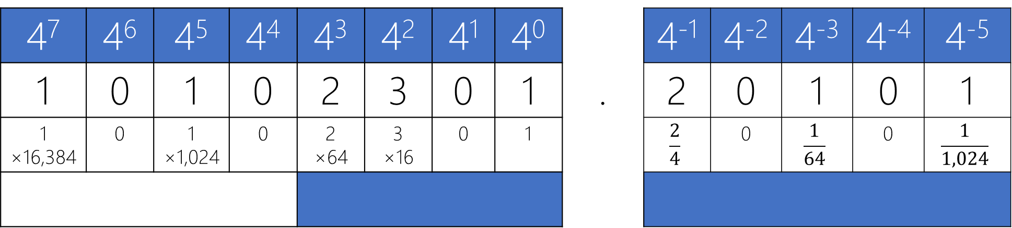
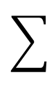
Integer Part
Fraction Part
4⁷ | 4⁶ | 4⁵ | 4⁴ | 4³ | 4² | 4¹ | 4⁰ | . | 4⁻¹ | 4⁻² | 4⁻³ | 4⁻⁴ | 4⁻⁵
1 | 0 | 1 | 0 | 2 | 3 | 0 | 1 |  | 2 | 0 | 1 | 0 | 1
1 ×16,384 | 0 | 1 ×1,024 | 0 | 2 ×64 | 3 ×16 | 0 | 1 |  | $$\frac{2}{4}$$ | 0 | $$\frac{1}{64}$$ | 0 | $$\frac{1}{1,024}$$
×

Slide 88
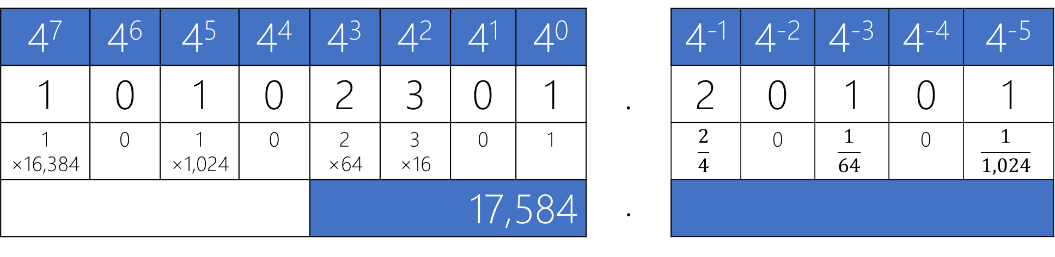
Integer Part
Fraction Part
4⁷ | 4⁶ | 4⁵ | 4⁴ | 4³ | 4² | 4¹ | 4⁰ | . | 4⁻¹ | 4⁻² | 4⁻³ | 4⁻⁴ | 4⁻⁵
1 | 0 | 1 | 0 | 2 | 3 | 0 | 1 |  | 2 | 0 | 1 | 0 | 1
1 ×16,384 | 0 | 1 ×1,024 | 0 | 2 ×64 | 3 ×16 | 0 | 1 |  | $$\frac{2}{4}$$ | 0 | $$\frac{1}{64}$$ | 0 | $$\frac{1}{1,024}$$
 |  |  |  | 17,584 |  |  |  | .
×
Notes:
1*4^7+1*4^5+2*4^3+3*4^2+1*4^0

Slide 89
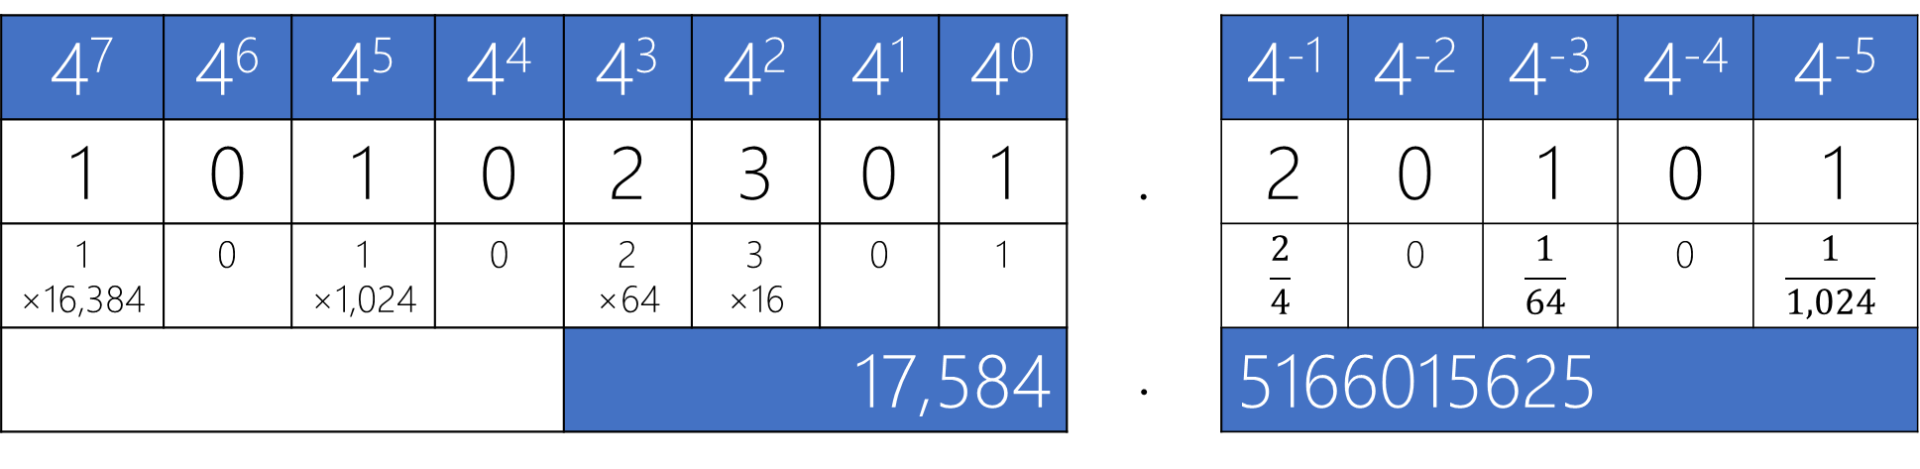
Integer Part
Fraction Part
4⁷ | 4⁶ | 4⁵ | 4⁴ | 4³ | 4² | 4¹ | 4⁰ | . | 4⁻¹ | 4⁻² | 4⁻³ | 4⁻⁴ | 4⁻⁵
1 | 0 | 1 | 0 | 2 | 3 | 0 | 1 |  | 2 | 0 | 1 | 0 | 1
1 ×16,384 | 0 | 1 ×1,024 | 0 | 2 ×64 | 3 ×16 | 0 | 1 |  | $$\frac{2}{4}$$ | 0 | $$\frac{1}{64}$$ | 0 | $$\frac{1}{1,024}$$
 |  |  |  | 17,584 |  |  |  | . | 5166015625
×

Slide 90
Let (N)_{r} be a radix-r (base-r) number in a positional weighting number system, then
(N)_{r} = (d_{n-1} r^{n-1} + ... + d₀r⁰ . d₋₁ r⁻¹ + d₋₂ r⁻² + ... + d_{-m} r^{-m})₁₀
where:
r = radix (base)
d_{i} = digit at position i, 0 ≤ d_{i} ≤ r - 1
r^{i} = weight of position i
n = number of digits in integer part of N
m = number of digits in fraction part of N
Fraction Point

Slide 91
Let (N)_{r} be a radix-r (base-r) number in a positional weighting number system, then
Min = (0_{n-1} ... 0₁0₀ . 0₋₁0₋₂ ... 0_{-m-1}0_{-m})_{r} = (0 . 0)₁₀
Max = ((r-1)_{n-1} ... (r-1)₀ . (r-1)₋₁(r-1)₋₂ ... (r-1)_{-m-1}(r-1)_{-m})_{r} = (r^{n}-1 . ? )₁₀
Unit = (0_{n-1} ... 0₁0₀ . 0₋₁0₋₂ ... 0_{-m-1}1_{-m})_{r} = (r^{-m})₁₀
where:
r = radix (base)
r^{i} = weight of position i
n = number of digits in integer part of N
m = number of digits in fraction part of N
Lecture Assignment

Slide 92
Practice Radix-2

Slide 93
Radix-2 |  |  |  |  |  |  |  | Radix-10
Integer (n=4) |  |  |  |  | Fraction (m=3)
2³ | 2² | 2¹ | 2⁰ | . | 2⁻¹ | 2⁻² | 2⁻³
0 | 0 | 0 | 0 | . | 0 | 0 | 0 | 0
0 | 0 | 0 | 0 | . | 0 | 0 | 1 | 1*2⁻³ = 1/8 = 0.125
0 | 0 | 0 | 0 | . | 0 | 1 | 0 | 1*2⁻² + 0*2⁻³ = 1/4 = 0.25
0 | 0 | 0 | 0 | . | 0 | 1 | 1 | 1*2⁻² + 1*2⁻³ = 1/4 + 1/8 = 3/8 = 0.375
0 | 0 | 0 | 0 | . | 1 | 0 | 0 | 1*2⁻¹ + 0*2⁻² + 0*2⁻³ = ½ = 0.5
0 | 0 | 0 | 0 | . | 1 | 0 | 1 | 1*2⁻¹ + 0*2⁻² + 1*2⁻³ = 1/2 + 1/8 = 5/8 = 0.625
0 | 0 | 0 | 0 | . | 1 | 1 | 0 | 1*2⁻¹ + 1*2⁻² + 0*2⁻³ = 1/2 + 1/4 = 3/4 = 0.75
0 | 0 | 0 | 0 | . | 1 | 1 | 1 | 1*2⁻¹ + 1*2⁻² + 1*2⁻³ = 1/2 + 1/4 + 1/8 = 0.875
0 | 0 | 0 | 1 | . | 0 | 0 | 0 | 1*2⁰ + 0*2⁻¹ + 0*2⁻² + 0*2⁻³ = 1
0 | 0 | 0 | 1 | . | 0 | 0 | 1 | 1.125
0 | 0 | 0 | 1 | . | 0 | 1 | 0 | 1.25
0 | 0 | 0 | 1 | . | 0 | 1 | 1 | 1.375
0 | 0 | 0 | 1 | . | 1 | 0 | 0 | 1.5
0 | 0 | 0 | 1 | . | 1 | 0 | 1 | 1.625
0 | 0 | 0 | 1 | . | 1 | 1 | 0 | 1.75
0 | 0 | 0 | 1 | . | 1 | 1 | 1 | 1.875
0 | 0 | 1 | 0 | . | 0 | 0 | 0 | 2

Slide 94
Radix-2 |  |  |  |  |  |  |  | Radix-10
Integer (n=4) |  |  |  |  | Fraction (m=3)
2³ | 2² | 2¹ | 2⁰ | . | 2⁻¹ | 2⁻² | 2⁻³
0 | 0 | 0 | 0 | . | 0 | 0 | 0 | 0
0 | 0 | 0 | 0 | . | 0 | 0 | 1 | 1*2⁻³ = 1/8 = 0.125
0 | 0 | 0 | 0 | . | 0 | 1 | 0 | 1*2⁻² + 0*2⁻³ = 1/4 = 0.25
0 | 0 | 0 | 0 | . | 0 | 1 | 1 | 1*2⁻² + 1*2⁻³ = 1/4 + 1/8 = 3/8 = 0.375
0 | 0 | 0 | 0 | . | 1 | 0 | 0 | 1*2⁻¹ + 0*2⁻² + 0*2⁻³ = ½ = 0.5
0 | 0 | 0 | 0 | . | 1 | 0 | 1 | 1*2⁻¹ + 0*2⁻² + 1*2⁻³ = 1/2 + 1/8 = 5/8 = 0.625
0 | 0 | 0 | 0 | . | 1 | 1 | 0 | 1*2⁻¹ + 1*2⁻² + 0*2⁻³ = 1/2 + 1/4 = 3/4 = 0.75
0 | 0 | 0 | 0 | . | 1 | 1 | 1 | 1*2⁻¹ + 1*2⁻² + 1*2⁻³ = 1/2 + 1/4 + 1/8 = 0.875
0 | 0 | 0 | 1 | . | 0 | 0 | 0 | 1*2⁰ + 0*2⁻¹ + 0*2⁻² + 0*2⁻³ = 1
0 | 0 | 0 | 1 | . | 0 | 0 | 1 | 1.125
0 | 0 | 0 | 1 | . | 0 | 1 | 0 | 1.25
0 | 0 | 0 | 1 | . | 0 | 1 | 1 | 1.375
0 | 0 | 0 | 1 | . | 1 | 0 | 0 | 1.5
0 | 0 | 0 | 1 | . | 1 | 0 | 1 | 1.625
0 | 0 | 0 | 1 | . | 1 | 1 | 0 | 1.75
0 | 0 | 0 | 1 | . | 1 | 1 | 1 | 1.875
0 | 0 | 1 | 0 | . | 0 | 0 | 0 | 2
What is the max in this system with these spaces?

Slide 95
Radix-2 |  |  |  |  |  |  |  | Radix-10
Integer (n=4) |  |  |  |  | Fraction (m=3)
2³ | 2² | 2¹ | 2⁰ | . | 2⁻¹ | 2⁻² | 2⁻³
0 | 0 | 0 | 0 | . | 0 | 0 | 0 | 0
0 | 0 | 0 | 0 | . | 0 | 0 | 1 | 1*2⁻³ = 1/8 = 0.125
0 | 0 | 0 | 0 | . | 0 | 1 | 0 | 1*2⁻² + 0*2⁻³ = 1/4 = 0.25
0 | 0 | 0 | 0 | . | 0 | 1 | 1 | 1*2⁻² + 1*2⁻³ = 1/4 + 1/8 = 3/8 = 0.375
0 | 0 | 0 | 0 | . | 1 | 0 | 0 | 1*2⁻¹ + 0*2⁻² + 0*2⁻³ = ½ = 0.5
0 | 0 | 0 | 0 | . | 1 | 0 | 1 | 1*2⁻¹ + 0*2⁻² + 1*2⁻³ = 1/2 + 1/8 = 5/8 = 0.625
0 | 0 | 0 | 0 | . | 1 | 1 | 0 | 1*2⁻¹ + 1*2⁻² + 0*2⁻³ = 1/2 + 1/4 = 3/4 = 0.75
0 | 0 | 0 | 0 | . | 1 | 1 | 1 | 1*2⁻¹ + 1*2⁻² + 1*2⁻³ = 1/2 + 1/4 + 1/8 = 0.875
0 | 0 | 0 | 1 | . | 0 | 0 | 0 | 1*2⁰ + 0*2⁻¹ + 0*2⁻² + 0*2⁻³ = 1
0 | 0 | 0 | 1 | . | 0 | 0 | 1 | 1.125
0 | 0 | 0 | 1 | . | 0 | 1 | 0 | 1.25
0 | 0 | 0 | 1 | . | 0 | 1 | 1 | 1.375
0 | 0 | 0 | 1 | . | 1 | 0 | 0 | 1.5
0 | 0 | 0 | 1 | . | 1 | 0 | 1 | 1.625
0 | 0 | 0 | 1 | . | 1 | 1 | 0 | 1.75
0 | 0 | 0 | 1 | . | 1 | 1 | 1 | 1.875
0 | 0 | 1 | 0 | . | 0 | 0 | 0 | 2
What is the max in this system with these spaces?
(1111.111)₂ = (15.875)₁₀

Slide 96
Radix-2 |  |  |  |  |  |  |  | Radix-10
Integer (n=4) |  |  |  |  | Fraction (m=3)
2³ | 2² | 2¹ | 2⁰ | . | 2⁻¹ | 2⁻² | 2⁻³
0 | 0 | 0 | 0 | . | 0 | 0 | 0 | 0
0 | 0 | 0 | 0 | . | 0 | 0 | 1 | 1*2⁻³ = 1/8 = 0.125
0 | 0 | 0 | 0 | . | 0 | 1 | 0 | 1*2⁻² + 0*2⁻³ = 1/4 = 0.25
0 | 0 | 0 | 0 | . | 0 | 1 | 1 | 1*2⁻² + 1*2⁻³ = 1/4 + 1/8 = 3/8 = 0.375
0 | 0 | 0 | 0 | . | 1 | 0 | 0 | 1*2⁻¹ + 0*2⁻² + 0*2⁻³ = ½ = 0.5
0 | 0 | 0 | 0 | . | 1 | 0 | 1 | 1*2⁻¹ + 0*2⁻² + 1*2⁻³ = 1/2 + 1/8 = 5/8 = 0.625
0 | 0 | 0 | 0 | . | 1 | 1 | 0 | 1*2⁻¹ + 1*2⁻² + 0*2⁻³ = 1/2 + 1/4 = 3/4 = 0.75
0 | 0 | 0 | 0 | . | 1 | 1 | 1 | 1*2⁻¹ + 1*2⁻² + 1*2⁻³ = 1/2 + 1/4 + 1/8 = 0.875
0 | 0 | 0 | 1 | . | 0 | 0 | 0 | 1*2⁰ + 0*2⁻¹ + 0*2⁻² + 0*2⁻³ = 1
0 | 0 | 0 | 1 | . | 0 | 0 | 1 | 1.125
0 | 0 | 0 | 1 | . | 0 | 1 | 0 | 1.25
0 | 0 | 0 | 1 | . | 0 | 1 | 1 | 1.375
0 | 0 | 0 | 1 | . | 1 | 0 | 0 | 1.5
0 | 0 | 0 | 1 | . | 1 | 0 | 1 | 1.625
0 | 0 | 0 | 1 | . | 1 | 1 | 0 | 1.75
0 | 0 | 0 | 1 | . | 1 | 1 | 1 | 1.875
0 | 0 | 1 | 0 | . | 0 | 0 | 0 | 2
Is it possible to show the number (1.02)₁₀ in this system with these spaces?

Slide 97
Radix-2 |  |  |  |  |  |  |  | Radix-10
Integer (n=4) |  |  |  |  | Fraction (m=3)
2³ | 2² | 2¹ | 2⁰ | . | 2⁻¹ | 2⁻² | 2⁻³
0 | 0 | 0 | 0 | . | 0 | 0 | 0 | 0
0 | 0 | 0 | 0 | . | 0 | 0 | 1 | 1*2⁻³ = 1/8 = 0.125
0 | 0 | 0 | 0 | . | 0 | 1 | 0 | 1*2⁻² + 0*2⁻³ = 1/4 = 0.25
0 | 0 | 0 | 0 | . | 0 | 1 | 1 | 1*2⁻² + 1*2⁻³ = 1/4 + 1/8 = 3/8 = 0.375
0 | 0 | 0 | 0 | . | 1 | 0 | 0 | 1*2⁻¹ + 0*2⁻² + 0*2⁻³ = ½ = 0.5
0 | 0 | 0 | 0 | . | 1 | 0 | 1 | 1*2⁻¹ + 0*2⁻² + 1*2⁻³ = 1/2 + 1/8 = 5/8 = 0.625
0 | 0 | 0 | 0 | . | 1 | 1 | 0 | 1*2⁻¹ + 1*2⁻² + 0*2⁻³ = 1/2 + 1/4 = 3/4 = 0.75
0 | 0 | 0 | 0 | . | 1 | 1 | 1 | 1*2⁻¹ + 1*2⁻² + 1*2⁻³ = 1/2 + 1/4 + 1/8 = 0.875
0 | 0 | 0 | 1 | . | 0 | 0 | 0 | 1*2⁰ + 0*2⁻¹ + 0*2⁻² + 0*2⁻³ = 1
0 | 0 | 0 | 1 | . | 0 | 0 | 1 | 1.125
0 | 0 | 0 | 1 | . | 0 | 1 | 0 | 1.25
0 | 0 | 0 | 1 | . | 0 | 1 | 1 | 1.375
0 | 0 | 0 | 1 | . | 1 | 0 | 0 | 1.5
0 | 0 | 0 | 1 | . | 1 | 0 | 1 | 1.625
0 | 0 | 0 | 1 | . | 1 | 1 | 0 | 1.75
0 | 0 | 0 | 1 | . | 1 | 1 | 1 | 1.875
0 | 0 | 1 | 0 | . | 0 | 0 | 0 | 2
Is it possible to show the number (1.02)₁₀ in this system with these spaces?
No! The numbers in this system increments by 0.125 unit.

Slide 98
Radix-2 |  |  |  |  |  |  |  | Radix-10
Integer (n=4) |  |  |  |  | Fraction (m=3)
2³ | 2² | 2¹ | 2⁰ | . | 2⁻¹ | 2⁻² | 2⁻³
0 | 0 | 0 | 0 | . | 0 | 0 | 0 | 0
0 | 0 | 0 | 0 | . | 0 | 0 | 1 | 1*2⁻³ = 1/8 = 0.125
0 | 0 | 0 | 0 | . | 0 | 1 | 0 | 1*2⁻² + 0*2⁻³ = 1/4 = 0.25
0 | 0 | 0 | 0 | . | 0 | 1 | 1 | 1*2⁻² + 1*2⁻³ = 1/4 + 1/8 = 3/8 = 0.375
0 | 0 | 0 | 0 | . | 1 | 0 | 0 | 1*2⁻¹ + 0*2⁻² + 0*2⁻³ = ½ = 0.5
0 | 0 | 0 | 0 | . | 1 | 0 | 1 | 1*2⁻¹ + 0*2⁻² + 1*2⁻³ = 1/2 + 1/8 = 5/8 = 0.625
0 | 0 | 0 | 0 | . | 1 | 1 | 0 | 1*2⁻¹ + 1*2⁻² + 0*2⁻³ = 1/2 + 1/4 = 3/4 = 0.75
0 | 0 | 0 | 0 | . | 1 | 1 | 1 | 1*2⁻¹ + 1*2⁻² + 1*2⁻³ = 1/2 + 1/4 + 1/8 = 0.875
0 | 0 | 0 | 1 | . | 0 | 0 | 0 | 1*2⁰ + 0*2⁻¹ + 0*2⁻² + 0*2⁻³ = 1
0 | 0 | 0 | 1 | . | 0 | 0 | 1 | 1.125
0 | 0 | 0 | 1 | . | 0 | 1 | 0 | 1.25
0 | 0 | 0 | 1 | . | 0 | 1 | 1 | 1.375
0 | 0 | 0 | 1 | . | 1 | 0 | 0 | 1.5
0 | 0 | 0 | 1 | . | 1 | 0 | 1 | 1.625
0 | 0 | 0 | 1 | . | 1 | 1 | 0 | 1.75
0 | 0 | 0 | 1 | . | 1 | 1 | 1 | 1.875
0 | 0 | 1 | 0 | . | 0 | 0 | 0 | 2
Is it possible to show the number (1.02)₁₀ in this system with these spaces?
No! The numbers in this system increments by 0.125 unit.
Solution?

Slide 99
Radix-2 |  |  |  |  |  |  |  | Radix-10
Integer (n=4) |  |  |  |  | Fraction (m=3)
2³ | 2² | 2¹ | 2⁰ | . | 2⁻¹ | 2⁻² | 2⁻³
0 | 0 | 0 | 0 | . | 0 | 0 | 0 | 0
0 | 0 | 0 | 0 | . | 0 | 0 | 1 | 1*2⁻³ = 1/8 = 0.125
0 | 0 | 0 | 0 | . | 0 | 1 | 0 | 1*2⁻² + 0*2⁻³ = 1/4 = 0.25
0 | 0 | 0 | 0 | . | 0 | 1 | 1 | 1*2⁻² + 1*2⁻³ = 1/4 + 1/8 = 3/8 = 0.375
0 | 0 | 0 | 0 | . | 1 | 0 | 0 | 1*2⁻¹ + 0*2⁻² + 0*2⁻³ = ½ = 0.5
0 | 0 | 0 | 0 | . | 1 | 0 | 1 | 1*2⁻¹ + 0*2⁻² + 1*2⁻³ = 1/2 + 1/8 = 5/8 = 0.625
0 | 0 | 0 | 0 | . | 1 | 1 | 0 | 1*2⁻¹ + 1*2⁻² + 0*2⁻³ = 1/2 + 1/4 = 3/4 = 0.75
0 | 0 | 0 | 0 | . | 1 | 1 | 1 | 1*2⁻¹ + 1*2⁻² + 1*2⁻³ = 1/2 + 1/4 + 1/8 = 0.875
0 | 0 | 0 | 1 | . | 0 | 0 | 0 | 1*2⁰ + 0*2⁻¹ + 0*2⁻² + 0*2⁻³ = 1
0 | 0 | 0 | 1 | . | 0 | 0 | 1 | 1.125
0 | 0 | 0 | 1 | . | 0 | 1 | 0 | 1.25
0 | 0 | 0 | 1 | . | 0 | 1 | 1 | 1.375
0 | 0 | 0 | 1 | . | 1 | 0 | 0 | 1.5
0 | 0 | 0 | 1 | . | 1 | 0 | 1 | 1.625
0 | 0 | 0 | 1 | . | 1 | 1 | 0 | 1.75
0 | 0 | 0 | 1 | . | 1 | 1 | 1 | 1.875
0 | 0 | 1 | 0 | . | 0 | 0 | 0 | 2
Is it possible to show the number (1.02)₁₀ in this system with these spaces?
No! The numbers in this system increments by 0.125 unit.
Solution?
A. More precision.

Slide 100
Radix-2 |  |  |  |  |  |  |  | Radix-10
Integer (n=4) |  |  |  |  | Fraction (m=3)
2³ | 2² | 2¹ | 2⁰ | . | 2⁻¹ | 2⁻² | 2⁻³
0 | 0 | 0 | 0 | . | 0 | 0 | 0 | 0
0 | 0 | 0 | 0 | . | 0 | 0 | 1 | 1*2⁻³ = 1/8 = 0.125
0 | 0 | 0 | 0 | . | 0 | 1 | 0 | 1*2⁻² + 0*2⁻³ = 1/4 = 0.25
0 | 0 | 0 | 0 | . | 0 | 1 | 1 | 1*2⁻² + 1*2⁻³ = 1/4 + 1/8 = 3/8 = 0.375
0 | 0 | 0 | 0 | . | 1 | 0 | 0 | 1*2⁻¹ + 0*2⁻² + 0*2⁻³ = ½ = 0.5
0 | 0 | 0 | 0 | . | 1 | 0 | 1 | 1*2⁻¹ + 0*2⁻² + 1*2⁻³ = 1/2 + 1/8 = 5/8 = 0.625
0 | 0 | 0 | 0 | . | 1 | 1 | 0 | 1*2⁻¹ + 1*2⁻² + 0*2⁻³ = 1/2 + 1/4 = 3/4 = 0.75
0 | 0 | 0 | 0 | . | 1 | 1 | 1 | 1*2⁻¹ + 1*2⁻² + 1*2⁻³ = 1/2 + 1/4 + 1/8 = 0.875
0 | 0 | 0 | 1 | . | 0 | 0 | 0 | 1*2⁰ + 0*2⁻¹ + 0*2⁻² + 0*2⁻³ = 1
0 | 0 | 0 | 1 | . | 0 | 0 | 1 | 1.125
0 | 0 | 0 | 1 | . | 0 | 1 | 0 | 1.25
0 | 0 | 0 | 1 | . | 0 | 1 | 1 | 1.375
0 | 0 | 0 | 1 | . | 1 | 0 | 0 | 1.5
0 | 0 | 0 | 1 | . | 1 | 0 | 1 | 1.625
0 | 0 | 0 | 1 | . | 1 | 1 | 0 | 1.75
0 | 0 | 0 | 1 | . | 1 | 1 | 1 | 1.875
0 | 0 | 1 | 0 | . | 0 | 0 | 0 | 2
Is it possible to show the number (1.02)₁₀ in this system with these spaces?
No! The numbers in this system increments by 0.125 unit.
Solution?
A. More precision.
A. More fraction positions.

Slide 101
Radix-2 |  |  |  |  |  |  |  | Radix-10
Integer (n=4) |  |  |  |  | Fraction (m=3)
2³ | 2² | 2¹ | 2⁰ | . | 2⁻¹ | 2⁻² | 2⁻³
0 | 0 | 0 | 0 | . | 0 | 0 | 0 | 0
0 | 0 | 0 | 0 | . | 0 | 0 | 1 | 1*2⁻³ = 1/8 = 0.125
0 | 0 | 0 | 0 | . | 0 | 1 | 0 | 1*2⁻² + 0*2⁻³ = 1/4 = 0.25
0 | 0 | 0 | 0 | . | 0 | 1 | 1 | 1*2⁻² + 1*2⁻³ = 1/4 + 1/8 = 3/8 = 0.375
0 | 0 | 0 | 0 | . | 1 | 0 | 0 | 1*2⁻¹ + 0*2⁻² + 0*2⁻³ = ½ = 0.5
0 | 0 | 0 | 0 | . | 1 | 0 | 1 | 1*2⁻¹ + 0*2⁻² + 1*2⁻³ = 1/2 + 1/8 = 5/8 = 0.625
0 | 0 | 0 | 0 | . | 1 | 1 | 0 | 1*2⁻¹ + 1*2⁻² + 0*2⁻³ = 1/2 + 1/4 = 3/4 = 0.75
0 | 0 | 0 | 0 | . | 1 | 1 | 1 | 1*2⁻¹ + 1*2⁻² + 1*2⁻³ = 1/2 + 1/4 + 1/8 = 0.875
0 | 0 | 0 | 1 | . | 0 | 0 | 0 | 1*2⁰ + 0*2⁻¹ + 0*2⁻² + 0*2⁻³ = 1
0 | 0 | 0 | 1 | . | 0 | 0 | 1 | 1.125
0 | 0 | 0 | 1 | . | 0 | 1 | 0 | 1.25
0 | 0 | 0 | 1 | . | 0 | 1 | 1 | 1.375
0 | 0 | 0 | 1 | . | 1 | 0 | 0 | 1.5
0 | 0 | 0 | 1 | . | 1 | 0 | 1 | 1.625
0 | 0 | 0 | 1 | . | 1 | 1 | 0 | 1.75
0 | 0 | 0 | 1 | . | 1 | 1 | 1 | 1.875
0 | 0 | 1 | 0 | . | 0 | 0 | 0 | 2
Is it possible to show the number (1.02)₁₀ in this system with these spaces?
No! The numbers in this system increments by 0.125 unit.
Solution?
A. More precision.
A. More fraction positions.
A. More in m!

Slide 102
Radix-2 |  |  |  |  |  |  |  | Radix-10
Integer (n=4) |  |  |  |  | Fraction (m=3)
2³ | 2² | 2¹ | 2⁰ | . | 2⁻¹ | 2⁻² | 2⁻³
0 | 0 | 0 | 0 | . | 0 | 0 | 0 | 0
0 | 0 | 0 | 0 | . | 0 | 0 | 1 | 1*2⁻³ = 1/8 = 0.125
0 | 0 | 0 | 0 | . | 0 | 1 | 0 | 1*2⁻² + 0*2⁻³ = 1/4 = 0.25
0 | 0 | 0 | 0 | . | 0 | 1 | 1 | 1*2⁻² + 1*2⁻³ = 1/4 + 1/8 = 3/8 = 0.375
0 | 0 | 0 | 0 | . | 1 | 0 | 0 | 1*2⁻¹ + 0*2⁻² + 0*2⁻³ = ½ = 0.5
0 | 0 | 0 | 0 | . | 1 | 0 | 1 | 1*2⁻¹ + 0*2⁻² + 1*2⁻³ = 1/2 + 1/8 = 5/8 = 0.625
0 | 0 | 0 | 0 | . | 1 | 1 | 0 | 1*2⁻¹ + 1*2⁻² + 0*2⁻³ = 1/2 + 1/4 = 3/4 = 0.75
0 | 0 | 0 | 0 | . | 1 | 1 | 1 | 1*2⁻¹ + 1*2⁻² + 1*2⁻³ = 1/2 + 1/4 + 1/8 = 0.875
0 | 0 | 0 | 1 | . | 0 | 0 | 0 | 1*2⁰ + 0*2⁻¹ + 0*2⁻² + 0*2⁻³ = 1
0 | 0 | 0 | 1 | . | 0 | 0 | 1 | 1.125
0 | 0 | 0 | 1 | . | 0 | 1 | 0 | 1.25
0 | 0 | 0 | 1 | . | 0 | 1 | 1 | 1.375
0 | 0 | 0 | 1 | . | 1 | 0 | 0 | 1.5
0 | 0 | 0 | 1 | . | 1 | 0 | 1 | 1.625
0 | 0 | 0 | 1 | . | 1 | 1 | 0 | 1.75
0 | 0 | 0 | 1 | . | 1 | 1 | 1 | 1.875
0 | 0 | 1 | 0 | . | 0 | 0 | 0 | 2
Is it possible to show the number (1.02)₁₀ in this system with these spaces?
No! The numbers in this system increments by 0.125 unit.
Solution?
A. More precision.
A. More fraction positions.
A. More in m! How much?

Slide 103
Radix-2 |  |  |  |  |  |  |  | Radix-10
Integer (n=4) |  |  |  |  | Fraction (m=3)
2³ | 2² | 2¹ | 2⁰ | . | 2⁻¹ | 2⁻² | 2⁻³
0 | 0 | 0 | 0 | . | 0 | 0 | 0 | 0
0 | 0 | 0 | 0 | . | 0 | 0 | 1 | 1*2⁻³ = 1/8 = 0.125
0 | 0 | 0 | 0 | . | 0 | 1 | 0 | 1*2⁻² + 0*2⁻³ = 1/4 = 0.25
0 | 0 | 0 | 0 | . | 0 | 1 | 1 | 1*2⁻² + 1*2⁻³ = 1/4 + 1/8 = 3/8 = 0.375
0 | 0 | 0 | 0 | . | 1 | 0 | 0 | 1*2⁻¹ + 0*2⁻² + 0*2⁻³ = ½ = 0.5
0 | 0 | 0 | 0 | . | 1 | 0 | 1 | 1*2⁻¹ + 0*2⁻² + 1*2⁻³ = 1/2 + 1/8 = 5/8 = 0.625
0 | 0 | 0 | 0 | . | 1 | 1 | 0 | 1*2⁻¹ + 1*2⁻² + 0*2⁻³ = 1/2 + 1/4 = 3/4 = 0.75
0 | 0 | 0 | 0 | . | 1 | 1 | 1 | 1*2⁻¹ + 1*2⁻² + 1*2⁻³ = 1/2 + 1/4 + 1/8 = 0.875
0 | 0 | 0 | 1 | . | 0 | 0 | 0 | 1*2⁰ + 0*2⁻¹ + 0*2⁻² + 0*2⁻³ = 1
0 | 0 | 0 | 1 | . | 0 | 0 | 1 | 1.125
0 | 0 | 0 | 1 | . | 0 | 1 | 0 | 1.25
0 | 0 | 0 | 1 | . | 0 | 1 | 1 | 1.375
0 | 0 | 0 | 1 | . | 1 | 0 | 0 | 1.5
0 | 0 | 0 | 1 | . | 1 | 0 | 1 | 1.625
0 | 0 | 0 | 1 | . | 1 | 1 | 0 | 1.75
0 | 0 | 0 | 1 | . | 1 | 1 | 1 | 1.875
0 | 0 | 1 | 0 | . | 0 | 0 | 0 | 2
Is it possible to show the number (1.02)₁₀ in this system with these spaces?
No! The numbers in this system increments by 0.125 unit.
Solution?
B. Find the closest number

Slide 104
Radix-2 |  |  |  |  |  |  |  | Radix-10
Integer (n=4) |  |  |  |  | Fraction (m=3)
2³ | 2² | 2¹ | 2⁰ | . | 2⁻¹ | 2⁻² | 2⁻³
0 | 0 | 0 | 0 | . | 0 | 0 | 0 | 0
0 | 0 | 0 | 0 | . | 0 | 0 | 1 | 1*2⁻³ = 1/8 = 0.125
0 | 0 | 0 | 0 | . | 0 | 1 | 0 | 1*2⁻² + 0*2⁻³ = 1/4 = 0.25
0 | 0 | 0 | 0 | . | 0 | 1 | 1 | 1*2⁻² + 1*2⁻³ = 1/4 + 1/8 = 3/8 = 0.375
0 | 0 | 0 | 0 | . | 1 | 0 | 0 | 1*2⁻¹ + 0*2⁻² + 0*2⁻³ = ½ = 0.5
0 | 0 | 0 | 0 | . | 1 | 0 | 1 | 1*2⁻¹ + 0*2⁻² + 1*2⁻³ = 1/2 + 1/8 = 5/8 = 0.625
0 | 0 | 0 | 0 | . | 1 | 1 | 0 | 1*2⁻¹ + 1*2⁻² + 0*2⁻³ = 1/2 + 1/4 = 3/4 = 0.75
0 | 0 | 0 | 0 | . | 1 | 1 | 1 | 1*2⁻¹ + 1*2⁻² + 1*2⁻³ = 1/2 + 1/4 + 1/8 = 0.875
0 | 0 | 0 | 1 | . | 0 | 0 | 0 | 1*2⁰ + 0*2⁻¹ + 0*2⁻² + 0*2⁻³ = 1
0 | 0 | 0 | 1 | . | 0 | 0 | 1 | 1.125
0 | 0 | 0 | 1 | . | 0 | 1 | 0 | 1.25
0 | 0 | 0 | 1 | . | 0 | 1 | 1 | 1.375
0 | 0 | 0 | 1 | . | 1 | 0 | 0 | 1.5
0 | 0 | 0 | 1 | . | 1 | 0 | 1 | 1.625
0 | 0 | 0 | 1 | . | 1 | 1 | 0 | 1.75
0 | 0 | 0 | 1 | . | 1 | 1 | 1 | 1.875
0 | 0 | 1 | 0 | . | 0 | 0 | 0 | 2
Is it possible to show the number (1.02)₁₀ in this system with these spaces?
No! The numbers in this system increments by 0.125 unit.
Solution?
B. Find the closest number
(1.000)₂ =(1)₁₀ => Error = 0.02
(1.001)₂ =(1.125)₁₀ => Error = 0.105

Slide 105
Radix-2 |  |  |  |  |  |  |  | Radix-10
Integer (n=4) |  |  |  |  | Fraction (m=3)
2³ | 2² | 2¹ | 2⁰ | . | 2⁻¹ | 2⁻² | 2⁻³
0 | 0 | 0 | 0 | . | 0 | 0 | 0 | 0
0 | 0 | 0 | 0 | . | 0 | 0 | 1 | 1*2⁻³ = 1/8 = 0.125
0 | 0 | 0 | 0 | . | 0 | 1 | 0 | 1*2⁻² + 0*2⁻³ = 1/4 = 0.25
0 | 0 | 0 | 0 | . | 0 | 1 | 1 | 1*2⁻² + 1*2⁻³ = 1/4 + 1/8 = 3/8 = 0.375
0 | 0 | 0 | 0 | . | 1 | 0 | 0 | 1*2⁻¹ + 0*2⁻² + 0*2⁻³ = ½ = 0.5
0 | 0 | 0 | 0 | . | 1 | 0 | 1 | 1*2⁻¹ + 0*2⁻² + 1*2⁻³ = 1/2 + 1/8 = 5/8 = 0.625
0 | 0 | 0 | 0 | . | 1 | 1 | 0 | 1*2⁻¹ + 1*2⁻² + 0*2⁻³ = 1/2 + 1/4 = 3/4 = 0.75
0 | 0 | 0 | 0 | . | 1 | 1 | 1 | 1*2⁻¹ + 1*2⁻² + 1*2⁻³ = 1/2 + 1/4 + 1/8 = 0.875
0 | 0 | 0 | 1 | . | 0 | 0 | 0 | 1*2⁰ + 0*2⁻¹ + 0*2⁻² + 0*2⁻³ = 1
0 | 0 | 0 | 1 | . | 0 | 0 | 1 | 1.125
0 | 0 | 0 | 1 | . | 0 | 1 | 0 | 1.25
0 | 0 | 0 | 1 | . | 0 | 1 | 1 | 1.375
0 | 0 | 0 | 1 | . | 1 | 0 | 0 | 1.5
0 | 0 | 0 | 1 | . | 1 | 0 | 1 | 1.625
0 | 0 | 0 | 1 | . | 1 | 1 | 0 | 1.75
0 | 0 | 0 | 1 | . | 1 | 1 | 1 | 1.875
0 | 0 | 1 | 0 | . | 0 | 0 | 0 | 2
Is it possible to show the number (1.02)₁₀ in this system with these spaces?
No! The numbers in this system increments by 0.125 unit.
Solution?
B. Find the closest number
(1.000)₂ =(1)₁₀ => Error = 0.02
(1.001)₂ =(1.125)₁₀ => Error = 0.105

Slide 106
Practice Radix-4

Slide 107
Radix-4 |  |  |  |  |  |  |  | Radix-10
Integer (n=4) |  |  |  |  | Fraction (m=3)
4³ | 4² | 4¹ | 4⁰ | . | 4⁻¹ | 4⁻² | 4⁻³
0 | 0 | 0 | 0 | . | 0 | 0 | 0 | 0
0 | 0 | 0 | 0 | . | 0 | 0 | 1 | 1*4⁻³ = 1/64 = 0.015625
0 | 0 | 0 | 0 | . | 0 | 0 | 2 | 2*4⁻³ = 2/64 = 0.03125
0 | 0 | 0 | 0 | . | 0 | 0 | 3 | 3*4⁻³ = 3/64 = 0.046875
0 | 0 | 0 | 0 | . | 0 | 1 | 0 | 1*4⁻² + 0*4⁻² = 1/16 = 0.0625
0 | 0 | 0 | 0 | . | 0 | 1 | 1 | 1*4⁻² + 1*4⁻² = 1/16 + 1/64 = 0.078125
0 | 0 | 0 | 0 | . | 0 | 1 | 2 | 1*4⁻² + 2*4⁻² = 1/16 + 2/64 = 0.09375
0 | 0 | 0 | 0 | . | 0 | 1 | 3 | 1*4⁻² + 3*4⁻² = 1/16 + 3/64 = 0.109375
0 | 0 | 0 | 0 | . | 0 | 2 | 0 | 2*4⁻² + 0*4⁻² = 2/16 = 0.125
…
0 | 0 | 0 | 0 | . | 3 | 3 | 3 | 3*4⁻¹ + 3*4⁻² + 3*4⁻³ = 0.984375
0 | 0 | 0 | 1 | . | 0 | 0 | 0 | 1
…
3 | 3 | 3 | 3 | . | 3 | 3 | 0 | 3*4³ + 3*4² + 3*4¹+3*4⁰+3*4⁻¹ + 3*4⁻² + 0*4⁻³ = ?
3 | 3 | 3 | 3 | . | 3 | 3 | 1 | 3*4³ + 3*4² + 3*4¹+3*4⁰+3*4⁻¹ + 3*4⁻² + 1*4⁻³ = ?
3 | 3 | 3 | 3 | . | 3 | 3 | 2 | 3*4³ + 3*4² + 3*4¹+3*4⁰+3*4⁻¹ + 3*4⁻² + 2*4⁻³ = ?
3 | 3 | 3 | 3 | . | 3 | 3 | 3 | 255.984375

Slide 108
Radix-4 |  |  |  |  |  |  |  | Radix-10
Integer (n=4) |  |  |  |  | Fraction (m=3)
4³ | 4² | 4¹ | 4⁰ | . | 4⁻¹ | 4⁻² | 4⁻³
0 | 0 | 0 | 0 | . | 0 | 0 | 0 | 0
0 | 0 | 0 | 0 | . | 0 | 0 | 1 | 1*4⁻³ = 1/64 = 0.015625
0 | 0 | 0 | 0 | . | 0 | 0 | 2 | 2*4⁻³ = 2/64 = 0.03125
0 | 0 | 0 | 0 | . | 0 | 0 | 3 | 3*4⁻³ = 3/64 = 0.046875
0 | 0 | 0 | 0 | . | 0 | 1 | 0 | 1*4⁻² + 0*4⁻² = 1/16 = 0.0625
0 | 0 | 0 | 0 | . | 0 | 1 | 1 | 1*4⁻² + 1*4⁻² = 1/16 + 1/64 = 0.078125
0 | 0 | 0 | 0 | . | 0 | 1 | 2 | 1*4⁻² + 2*4⁻² = 1/16 + 2/64 = 0.09375
0 | 0 | 0 | 0 | . | 0 | 1 | 3 | 1*4⁻² + 3*4⁻² = 1/16 + 3/64 = 0.109375
0 | 0 | 0 | 0 | . | 0 | 2 | 0 | 2*4⁻² + 0*4⁻² = 2/16 = 0.125
…
0 | 0 | 0 | 0 | . | 3 | 3 | 3 | 3*4⁻¹ + 3*4⁻² + 3*4⁻³ = 0.984375
0 | 0 | 0 | 1 | . | 0 | 0 | 0 | 1
…
3 | 3 | 3 | 3 | . | 3 | 3 | 0 | 3*4³ + 3*4² + 3*4¹+3*4⁰+3*4⁻¹ + 3*4⁻² + 0*4⁻³ = ?
3 | 3 | 3 | 3 | . | 3 | 3 | 1 | 3*4³ + 3*4² + 3*4¹+3*4⁰+3*4⁻¹ + 3*4⁻² + 1*4⁻³ = ?
3 | 3 | 3 | 3 | . | 3 | 3 | 2 | 3*4³ + 3*4² + 3*4¹+3*4⁰+3*4⁻¹ + 3*4⁻² + 2*4⁻³ = ?
3 | 3 | 3 | 3 | . | 3 | 3 | 3 | 255.984375
Is it possible to show the number (1.02)₁₀ in this system with these spaces?

Slide 109
Radix-4 |  |  |  |  |  |  |  | Radix-10
Integer (n=4) |  |  |  |  | Fraction (m=3)
4³ | 4² | 4¹ | 4⁰ | . | 4⁻¹ | 4⁻² | 4⁻³
0 | 0 | 0 | 0 | . | 0 | 0 | 0 | 0
0 | 0 | 0 | 0 | . | 0 | 0 | 1 | 1*4⁻³ = 1/64 = 0.015625
0 | 0 | 0 | 0 | . | 0 | 0 | 2 | 2*4⁻³ = 2/64 = 0.03125
0 | 0 | 0 | 0 | . | 0 | 0 | 3 | 3*4⁻³ = 3/64 = 0.046875
0 | 0 | 0 | 0 | . | 0 | 1 | 0 | 1*4⁻² + 0*4⁻² = 1/16 = 0.0625
0 | 0 | 0 | 0 | . | 0 | 1 | 1 | 1*4⁻² + 1*4⁻² = 1/16 + 1/64 = 0.078125
0 | 0 | 0 | 0 | . | 0 | 1 | 2 | 1*4⁻² + 2*4⁻² = 1/16 + 2/64 = 0.09375
0 | 0 | 0 | 0 | . | 0 | 1 | 3 | 1*4⁻² + 3*4⁻² = 1/16 + 3/64 = 0.109375
0 | 0 | 0 | 0 | . | 0 | 2 | 0 | 2*4⁻² + 0*4⁻² = 2/16 = 0.125
…
0 | 0 | 0 | 0 | . | 3 | 3 | 3 | 3*4⁻¹ + 3*4⁻² + 3*4⁻³ = 0.984375
0 | 0 | 0 | 1 | . | 0 | 0 | 0 | 1
…
3 | 3 | 3 | 3 | . | 3 | 3 | 0 | 3*4³ + 3*4² + 3*4¹+3*4⁰+3*4⁻¹ + 3*4⁻² + 0*4⁻³ = ?
3 | 3 | 3 | 3 | . | 3 | 3 | 1 | 3*4³ + 3*4² + 3*4¹+3*4⁰+3*4⁻¹ + 3*4⁻² + 1*4⁻³ = ?
3 | 3 | 3 | 3 | . | 3 | 3 | 2 | 3*4³ + 3*4² + 3*4¹+3*4⁰+3*4⁻¹ + 3*4⁻² + 2*4⁻³ = ?
3 | 3 | 3 | 3 | . | 3 | 3 | 3 | 255.984375
Is it possible to show the number (1.02)₁₀ in this system with these spaces?
No! Why?

Slide 110
Radix-4 |  |  |  |  |  |  |  | Radix-10
Integer (n=4) |  |  |  |  | Fraction (m=3)
4³ | 4² | 4¹ | 4⁰ | . | 4⁻¹ | 4⁻² | 4⁻³
0 | 0 | 0 | 0 | . | 0 | 0 | 0 | 0
0 | 0 | 0 | 0 | . | 0 | 0 | 1 | 1*4⁻³ = 1/64 = 0.015625
0 | 0 | 0 | 0 | . | 0 | 0 | 2 | 2*4⁻³ = 2/64 = 0.03125
0 | 0 | 0 | 0 | . | 0 | 0 | 3 | 3*4⁻³ = 3/64 = 0.046875
0 | 0 | 0 | 0 | . | 0 | 1 | 0 | 1*4⁻² + 0*4⁻² = 1/16 = 0.0625
0 | 0 | 0 | 0 | . | 0 | 1 | 1 | 1*4⁻² + 1*4⁻² = 1/16 + 1/64 = 0.078125
0 | 0 | 0 | 0 | . | 0 | 1 | 2 | 1*4⁻² + 2*4⁻² = 1/16 + 2/64 = 0.09375
0 | 0 | 0 | 0 | . | 0 | 1 | 3 | 1*4⁻² + 3*4⁻² = 1/16 + 3/64 = 0.109375
0 | 0 | 0 | 0 | . | 0 | 2 | 0 | 2*4⁻² + 0*4⁻² = 2/16 = 0.125
…
0 | 0 | 0 | 0 | . | 3 | 3 | 3 | 3*4⁻¹ + 3*4⁻² + 3*4⁻³ = 0.984375
0 | 0 | 0 | 1 | . | 0 | 0 | 0 | 1
…
3 | 3 | 3 | 3 | . | 3 | 3 | 0 | 3*4³ + 3*4² + 3*4¹+3*4⁰+3*4⁻¹ + 3*4⁻² + 0*4⁻³ = ?
3 | 3 | 3 | 3 | . | 3 | 3 | 1 | 3*4³ + 3*4² + 3*4¹+3*4⁰+3*4⁻¹ + 3*4⁻² + 1*4⁻³ = ?
3 | 3 | 3 | 3 | . | 3 | 3 | 2 | 3*4³ + 3*4² + 3*4¹+3*4⁰+3*4⁻¹ + 3*4⁻² + 2*4⁻³ = ?
3 | 3 | 3 | 3 | . | 3 | 3 | 3 | 255.984375
Is it possible to show the number (1.02)₁₀ in this system with these spaces?
No! Why?
Solution:
A. More in m
B. Find the closest number

Slide 111
Radix-4 |  |  |  |  |  |  |  | Radix-10
Integer (n=4) |  |  |  |  | Fraction (m=3)
4³ | 4² | 4¹ | 4⁰ | . | 4⁻¹ | 4⁻² | 4⁻³
0 | 0 | 0 | 0 | . | 0 | 0 | 0 | 0
0 | 0 | 0 | 0 | . | 0 | 0 | 1 | 1*4⁻³ = 1/64 = 0.015625
0 | 0 | 0 | 0 | . | 0 | 0 | 2 | 2*4⁻³ = 2/64 = 0.03125
0 | 0 | 0 | 0 | . | 0 | 0 | 3 | 3*4⁻³ = 3/64 = 0.046875
0 | 0 | 0 | 0 | . | 0 | 1 | 0 | 1*4⁻² + 0*4⁻² = 1/16 = 0.0625
0 | 0 | 0 | 0 | . | 0 | 1 | 1 | 1*4⁻² + 1*4⁻² = 1/16 + 1/64 = 0.078125
0 | 0 | 0 | 0 | . | 0 | 1 | 2 | 1*4⁻² + 2*4⁻² = 1/16 + 2/64 = 0.09375
0 | 0 | 0 | 0 | . | 0 | 1 | 3 | 1*4⁻² + 3*4⁻² = 1/16 + 3/64 = 0.109375
0 | 0 | 0 | 0 | . | 0 | 2 | 0 | 2*4⁻² + 0*4⁻² = 2/16 = 0.125
…
0 | 0 | 0 | 0 | . | 3 | 3 | 3 | 3*4⁻¹ + 3*4⁻² + 3*4⁻³ = 0.984375
0 | 0 | 0 | 1 | . | 0 | 0 | 0 | 1
0 | 0 | 0 | 1 | . | 0 | 0 | 1 | 1.015625
0 | 0 | 0 | 1 | . | 0 | 0 | 2 | 1.03125
…
3 | 3 | 3 | 3 | . | 3 | 3 | 2 | 3*4³ + 3*4² + 3*4¹+3*4⁰+3*4⁻¹ + 3*4⁻² + 2*4⁻³ = ?
3 | 3 | 3 | 3 | . | 3 | 3 | 3 | 255.984375
Is it possible to show the number (1.02)₁₀ in this system with these spaces?
No! Why?
Solution:
A. More in m
B. Find the closest number
(1.001)₄ = (1.015625)₁₀ => Error = 0.004375
(1.002)₄ = (1.03125)₁₀ => Error = 0.01125

Slide 112
Radix-4 |  |  |  |  |  |  |  | Radix-10
Integer (n=4) |  |  |  |  | Fraction (m=3)
4³ | 4² | 4¹ | 4⁰ | . | 4⁻¹ | 4⁻² | 4⁻³
0 | 0 | 0 | 0 | . | 0 | 0 | 0 | 0
0 | 0 | 0 | 0 | . | 0 | 0 | 1 | 1*4⁻³ = 1/64 = 0.015625
0 | 0 | 0 | 0 | . | 0 | 0 | 2 | 2*4⁻³ = 2/64 = 0.03125
0 | 0 | 0 | 0 | . | 0 | 0 | 3 | 3*4⁻³ = 3/64 = 0.046875
0 | 0 | 0 | 0 | . | 0 | 1 | 0 | 1*4⁻² + 0*4⁻² = 1/16 = 0.0625
0 | 0 | 0 | 0 | . | 0 | 1 | 1 | 1*4⁻² + 1*4⁻² = 1/16 + 1/64 = 0.078125
0 | 0 | 0 | 0 | . | 0 | 1 | 2 | 1*4⁻² + 2*4⁻² = 1/16 + 2/64 = 0.09375
0 | 0 | 0 | 0 | . | 0 | 1 | 3 | 1*4⁻² + 3*4⁻² = 1/16 + 3/64 = 0.109375
0 | 0 | 0 | 0 | . | 0 | 2 | 0 | 2*4⁻² + 0*4⁻² = 2/16 = 0.125
…
0 | 0 | 0 | 0 | . | 3 | 3 | 3 | 3*4⁻¹ + 3*4⁻² + 3*4⁻³ = 0.984375
0 | 0 | 0 | 1 | . | 0 | 0 | 0 | 1
0 | 0 | 0 | 1 | . | 0 | 0 | 1 | 1.015625
0 | 0 | 0 | 1 | . | 0 | 0 | 2 | 1.03125
…
3 | 3 | 3 | 3 | . | 3 | 3 | 2 | 3*4³ + 3*4² + 3*4¹+3*4⁰+3*4⁻¹ + 3*4⁻² + 2*4⁻³ = ?
3 | 3 | 3 | 3 | . | 3 | 3 | 3 | 255.984375
Is it possible to show the number (1.02)₁₀ in this system with these spaces?
No! Why?
Solution:
A. More in m
B. Find the closest number
(1.001)₄ = (1.015625)₁₀ => Error = 0.004375
(1.002)₄ = (1.03125)₁₀ => Error = 0.01125

Slide 113
Practice Radix-[8,10,16]
At Home

Slide 114
Conversion
From Base-r to Base-r’

Slide 115
(░)_{r} → (░)_{r’}

Slide 116
(░)_{r} → (░)₁₀
we already knew that: sum of the powers of r

Slide 117
Let (N)_{r} be a radix-r (base-r) number in a positional weighting number system, then
(N)_{r} = (d_{n-1} r^{n-1} + ... + d₀r⁰ . d₋₁ r⁻¹ + d₋₂ r⁻² + ... + d_{-m} r^{-m})₁₀
where:
r = radix (base)
d_{i} = digit at position i, 0 ≤ d_{i} ≤ r - 1
r^{i} = weight of position i
n = number of digits in integer part of N
m = number of digits in fraction part of N
Fraction Point

Slide 118
(░)_{r} ← (░)₁₀

Slide 119
(░)₁₀ ← (░)₁₀
To Come up with an Algorithm!

Slide 120
What is the digit in the position with significance of 10⁰?
( | 3 | 0 | 3 | 0 | 2 | 1 | 3 | 1 | )₁₀
Notes:
3×10^7+ 3×10^6+ 3×10^5+ 3×10^10+ 2×10^3+ 1×10^2+ 3×10^1+ 1×10^0 =

Slide 121
What is the digit in the position with significance of 10¹?
( | 3 | 0 | 3 | 0 | 2 | 1 | 3 | 1 | )₁₀
Notes:
3×10^7+ 3×10^6+ 3×10^5+ 3×10^10+ 2×10^3+ 1×10^2+ 3×10^1+ 1×10^0 =

Slide 122
What is the digit in the position with significance of 10²?
( | 3 | 0 | 3 | 0 | 2 | 1 | 3 | 1 | )₁₀
Notes:
3×10^7+ 3×10^6+ 3×10^5+ 3×10^10+ 2×10^3+ 1×10^2+ 3×10^1+ 1×10^0 =

Slide 123
What is the digit in the position with significance of 10^{i}?
(30302131)₁₀ → 10⁰ → 1
(30302131)₁₀ → 10¹ → 3
(30302131)₁₀ → 10² → 1
(30302131)₁₀ → 10³ → 2
(30302131)₁₀ → 10⁴ → 0
(30302131)₁₀ → 10⁵ → 3
(30302131)₁₀ → 10⁶ → 0
(30302131)₁₀ → 10⁷ → 3
Notes:
3×10^7+ 3×10^6+ 3×10^5+ 3×10^10+ 2×10^3+ 1×10^2+ 3×10^1+ 1×10^0 =

Slide 124
What is the digit in the position with significance of 10^{i}?
(30302131)₁₀ → 10⁰ → 1
(3030213)₁₀ → 10⁰ → 3
(303021)₁₀ → 10⁰ → 1
(30302)₁₀ → 10⁰ → 2
(3030)₁₀ → 10⁰ → 0
(303)₁₀ → 10⁰ → 3
(30)₁₀ → 10⁰ → 0
(3)₁₀ → 10⁰ → 3
Notes:
3×10^7+ 3×10^6+ 3×10^5+ 3×10^10+ 2×10^3+ 1×10^2+ 3×10^1+ 1×10^0 =

Slide 125
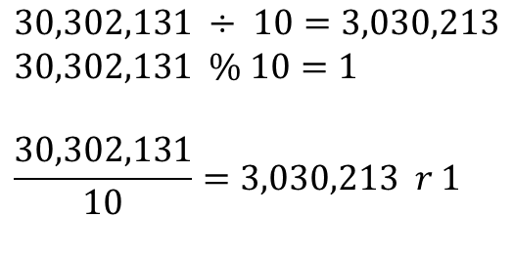
Divide by 10?
( | 3 | 0 | 3 | 0 | 2 | 1 | 3 | 1 | )₁₀
$$30,302,131 ÷ 10=3,030,213$$
$$30,302,131 \% 10=1$$
$$\frac{30,302,131}{10}=3,030,213 r 1$$
Notes:
3×10^7+ 3×10^6+ 3×10^5+ 3×10^10+ 2×10^3+ 1×10^2+ 3×10^1+ 1×10^0 =

Slide 126
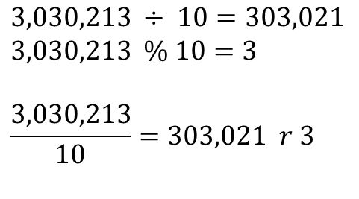
Divide by 10?
( | 3 | 0 | 3 | 0 | 2 | 1 | 3 | 1 | )₁₀
$$3,030,213 ÷ 10=303,021$$
$$3,030,213 \% 10=3$$
$$\frac{3,030,213}{10}=303,021 r 3$$
Notes:
3×10^7+ 3×10^6+ 3×10^5+ 3×10^10+ 2×10^3+ 1×10^2+ 3×10^1+ 1×10^0 =

Slide 127
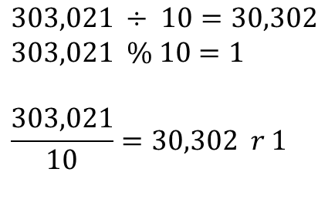
Divide by 10?
( | 3 | 0 | 3 | 0 | 2 | 1 | 3 | 1 | )₁₀
$$303,021 ÷ 10=30,302$$
$$303,021 \% 10=1$$
$$\frac{303,021}{10}=30,302 r 1$$
Notes:
3×10^7+ 3×10^6+ 3×10^5+ 3×10^10+ 2×10^3+ 1×10^2+ 3×10^1+ 1×10^0 =

Slide 128
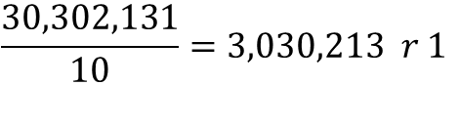
What is the digit in the position with significance of 10⁰?
$$\frac{30,302,131}{10}=3,030,213 r 1$$
Remainder of the 0+1 division by 10!
Notes:
3×10^7+ 3×10^6+ 3×10^5+ 3×10^10+ 2×10^3+ 1×10^2+ 3×10^1+ 1×10^0 =

Slide 129
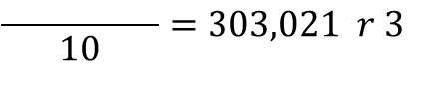
What is the digit in the position with significance of 10¹?
$$\frac{30,302,131}{10}=3,030,213 r 1$$
$$\frac{ }{10}=303,021 r 3$$
Remainder of the 1+1 division by 10!
Notes:
3×10^7+ 3×10^6+ 3×10^5+ 3×10^10+ 2×10^3+ 1×10^2+ 3×10^1+ 1×10^0 =

Slide 130
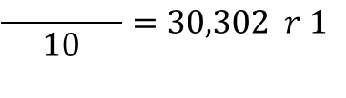
What is the digit in the position with significance of 10²?
$$\frac{30,302,131}{10}=3,030,213 r 1$$
$$\frac{ }{10}=303,021 r 3$$
$$\frac{ }{10}=30,302 r 1$$
Remainder of the 2+1 division by 10!
Notes:
3×10^7+ 3×10^6+ 3×10^5+ 3×10^10+ 2×10^3+ 1×10^2+ 3×10^1+ 1×10^0 =

Slide 131
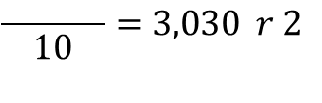
What is the digit in the position with significance of 10³?
$$\frac{30,302,131}{10}=3,030,213 r 1$$
$$\frac{ }{10}=303,021 r 3$$
$$\frac{ }{10}=30,302 r 1$$
$$\frac{ }{10}=3,030 r 2$$
Remainder of the 3+1 division by 10!
Notes:
3×10^7+ 3×10^6+ 3×10^5+ 3×10^10+ 2×10^3+ 1×10^2+ 3×10^1+ 1×10^0 =

Slide 132
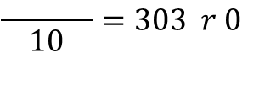
What is the digit in the position with significance of 10⁴?
$$\frac{30,302,131}{10}=3,030,213 r 1$$
$$\frac{ }{10}=303,021 r 3$$
$$\frac{ }{10}=30,302 r 1$$
$$\frac{ }{10}=3,030 r 2$$
$$\frac{ }{10}=303 r 0$$
Remainder of the 4+1 division by 10!
Notes:
3×10^7+ 3×10^6+ 3×10^5+ 3×10^10+ 2×10^3+ 1×10^2+ 3×10^1+ 1×10^0 =

Slide 133
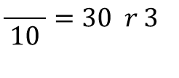
What is the digit in the position with significance of 10⁵?
$$\frac{30,302,131}{10}=3,030,213 r 1$$
$$\frac{ }{10}=303,021 r 3$$
$$\frac{ }{10}=30,302 r 1$$
$$\frac{ }{10}=3,030 r 2$$
$$\frac{ }{10}=303 r 0$$
$$\frac{ }{10}=30 r 3$$
Remainder of the 5+1 division by 10!
Notes:
3×10^7+ 3×10^6+ 3×10^5+ 3×10^10+ 2×10^3+ 1×10^2+ 3×10^1+ 1×10^0 =

Slide 134
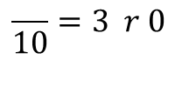
What is the digit in the position with significance of 10⁶?
$$\frac{30,302,131}{10}=3,030,213 r 1$$
$$\frac{ }{10}=303,021 r 3$$
$$\frac{ }{10}=30,302 r 1$$
$$\frac{ }{10}=3,030 r 2$$
$$\frac{ }{10}=303 r 0$$
$$\frac{ }{10}=30 r 3$$
$$\frac{ }{10}=3 r 0$$
Remainder of the 6+1 division by 10!
Notes:
3×10^7+ 3×10^6+ 3×10^5+ 3×10^10+ 2×10^3+ 1×10^2+ 3×10^1+ 1×10^0 =

Slide 135
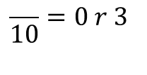
What is the digit in the position with significance of 10⁷?
$$\frac{30,302,131}{10}=3,030,213 r 1$$
$$\frac{ }{10}=303,021 r 3$$
$$\frac{ }{10}=30,302 r 1$$
$$\frac{ }{10}=3,030 r 2$$
$$\frac{ }{10}=303 r 0$$
$$\frac{ }{10}=30 r 3$$
$$\frac{ }{10}=3 r 0$$
$$\frac{ }{10}=0 r 3$$
Remainder of the 7+1 division by 10!
Notes:
3×10^7+ 3×10^6+ 3×10^5+ 3×10^10+ 2×10^3+ 1×10^2+ 3×10^1+ 1×10^0 =

Slide 136
What is the digit in the position with significance of 10^{i}?
$$\frac{30,302,131}{10}=3,030,213 r 1$$
$$\frac{ }{10}=303,021 r 3$$
$$\frac{ }{10}=30,302 r 1$$
$$\frac{ }{10}=3,030 r 2$$
$$\frac{ }{10}=303 r 0$$
$$\frac{ }{10}=30 r 3$$
$$\frac{ }{10}=3 r 0$$
$$\frac{ }{10}=0 r 3$$
( | 3 | 0 | 3 | 0 | 2 | 1 | 3 | 1 | )₁₀
Notes:
3×10^7+ 3×10^6+ 3×10^5+ 3×10^10+ 2×10^3+ 1×10^2+ 3×10^1+ 1×10^0 =

Slide 137
(░)₁₆ ← (░)₁₀

Slide 138
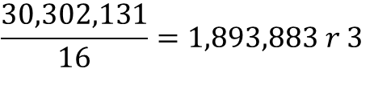
What is the digit in the position with significance of 16⁰?
$$\frac{30,302,131}{16}=1,893,883 r 3$$
Remainder of the 0+1 division by 16!
Notes:
3×10^7+ 3×10^6+ 3×10^5+ 3×10^10+ 2×10^3+ 1×10^2+ 3×10^1+ 1×10^0 =

Slide 139
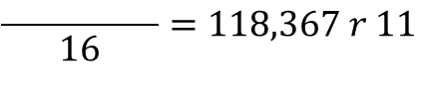
What is the digit in the position with significance of 16¹?
$$\frac{30,302,131}{16}=1,893,883 r 3$$
$$\frac{ }{16}=118,367 r 11$$
Remainder of the 1+1 division by 16!
Notes:
3×10^7+ 3×10^6+ 3×10^5+ 3×10^10+ 2×10^3+ 1×10^2+ 3×10^1+ 1×10^0 =

Slide 140
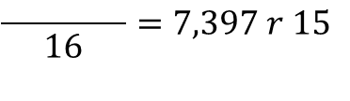
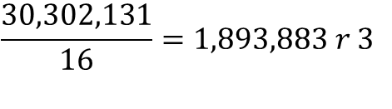
What is the digit in the position with significance of 16²?
$$\frac{30,302,131}{16}=1,893,883 r 3$$
$$\frac{ }{16}=118,367 r 11$$
$$\frac{ }{16}=7,397 r 15$$
Remainder of the 2+1 division by 16!
Notes:
3×10^7+ 3×10^6+ 3×10^5+ 3×10^10+ 2×10^3+ 1×10^2+ 3×10^1+ 1×10^0 =

Slide 141
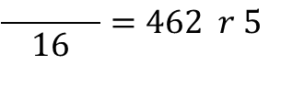
What is the digit in the position with significance of 16³?
$$\frac{30,302,131}{16}=1,893,883 r 3$$
$$\frac{ }{16}=118,367 r 11$$
$$\frac{ }{16}=7,397 r 15$$
$$\frac{ }{16}=462 r 5$$
Remainder of the 3+1 division by 16!
Notes:
3×10^7+ 3×10^6+ 3×10^5+ 3×10^10+ 2×10^3+ 1×10^2+ 3×10^1+ 1×10^0 =

Slide 142
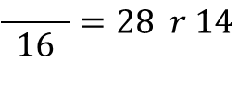
What is the digit in the position with significance of 16⁴?
$$\frac{30,302,131}{16}=1,893,883 r 3$$
$$\frac{ }{16}=118,367 r 11$$
$$\frac{ }{16}=7,397 r 15$$
$$\frac{ }{16}=462 r 5$$
$$\frac{ }{16}=28 r 14$$
Remainder of the 4+1 division by 16!
Notes:
3×10^7+ 3×10^6+ 3×10^5+ 3×10^10+ 2×10^3+ 1×10^2+ 3×10^1+ 1×10^0 =

Slide 143
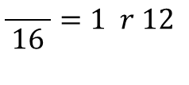
What is the digit in the position with significance of 16⁵?
$$\frac{30,302,131}{16}=1,893,883 r 3$$
$$\frac{ }{16}=118,367 r 11$$
$$\frac{ }{16}=7,397 r 15$$
$$\frac{ }{16}=462 r 5$$
$$\frac{ }{16}=28 r 14$$
$$\frac{ }{16}=1 r 12$$
Remainder of the 5+1 division by 16!
Notes:
3×10^7+ 3×10^6+ 3×10^5+ 3×10^10+ 2×10^3+ 1×10^2+ 3×10^1+ 1×10^0 =

Slide 144
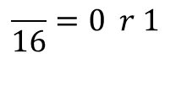
What is the digit in the position with significance of 16⁶?
$$\frac{30,302,131}{16}=1,893,883 r 3$$
$$\frac{ }{16}=118,367 r 11$$
$$\frac{ }{16}=7,397 r 15$$
$$\frac{ }{16}=462 r 5$$
$$\frac{ }{16}=28 r 14$$
$$\frac{ }{16}=1 r 12$$
$$\frac{ }{16}=0 r 1$$
Remainder of the 6+1 division by 16!
Notes:
3×10^7+ 3×10^6+ 3×10^5+ 3×10^10+ 2×10^3+ 1×10^2+ 3×10^1+ 1×10^0 =

Slide 145
What is the digit in the position with significance of 16⁶?
$$\frac{30,302,131}{16}=1,893,883 r 3$$
$$\frac{ }{16}=118,367 r 11$$
$$\frac{ }{16}=7,397 r 15$$
$$\frac{ }{16}=462 r 5$$
$$\frac{ }{16}=28 r 14$$
$$\frac{ }{16}=1 r 12$$
$$\frac{ }{16}=0 r 1$$
( | 1 | 12 | 14 | 5 | 15 | 11 | 3 | )₁₆
Notes:
3×10^7+ 3×10^6+ 3×10^5+ 3×10^10+ 2×10^3+ 1×10^2+ 3×10^1+ 1×10^0 =

Slide 146
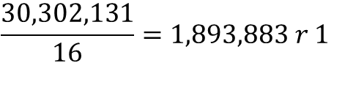
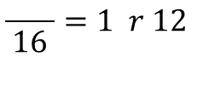
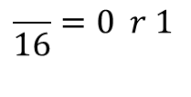
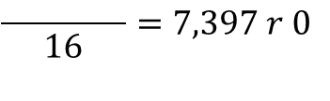
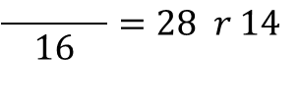
What is the digit in the position with significance of 16⁶?
$$\frac{30,302,131}{16}=1,893,883 r 1$$
$$\frac{ }{16}=118,367 r 11$$
$$\frac{ }{16}=7,397 r 0$$
$$\frac{ }{16}=462 r 5$$
$$\frac{ }{16}=28 r 14$$
$$\frac{ }{16}=1 r 12$$
$$\frac{ }{16}=0 r 1$$
( | 1 | 12 | 14 | 5 | 15 | 11 | 3 | )₁₆
Notes:
1CE5FB3

Slide 147
1,2,3,4,5,6,7,8,9,A
1,2,3,4,5,6,7,8,9,B
1,2,3,4,5,6,7,8,9,C
1,2,3,4,5,6,7,8,9,D
1,2,3,4,5,6,7,8,9,E
1,2,3,4,5,6,7,8,9,F
= 9 + 1
= A + 1
= B + 1
= C + 1
= D + 1
= E + 1
= (10)₁₀
= (11)₁₀
= (12)₁₀
= (13)₁₀
= (14)₁₀
= (15)₁₀

Slide 148
What is the digit in the position with significance of 16⁶?
$$\frac{30,302,131}{16}=1,893,883 r 1$$
$$\frac{ }{16}=118,367 r 11$$
$$\frac{ }{16}=7,397 r 0$$
$$\frac{ }{16}=462 r 5$$
$$\frac{ }{16}=28 r 14$$
$$\frac{ }{16}=1 r 12$$
$$\frac{ }{16}=0 r 1$$
( | 1 | C | E | 5 | F | B | 3 | )₁₆
Notes:
1CE5FB3

Slide 149
(░)₈ ← (░)₁₀

Slide 150
What is the digit in the position with significance of 8^{i}?
Quotient | Remainder
30,302,131÷8 | 3
3787766÷8 | 6
473470÷8 | 6
59183÷8 | 7
7397÷8 | 5
924÷8 | 4
115÷8 | 3
14÷8 | 6
1÷8 | 1
0
(1CE5FB3)₁₆
(30,302,131)₁₀
(163457663)₈

Slide 151
(░)₄ ← (░)₁₀

Slide 152
What is the digit in the position with significance of 4^{i}?
Quotient | Remainder
30,302,131÷4 | 3
7575532÷4 | 0
1893883÷4 | 3
473470÷4 | 2
118367÷4 | 3
29591÷4 | 3
7397÷4 | 1
1849÷4 | 1
462÷4 | 2
115÷4 | 3
28÷4 | 0
7÷4 | 3
1÷4 | 1
0
(1CE5FB3)₁₆
(30,302,131)₁₀
(163457663)₈
(1303211332303)₄

Slide 153
(░)₂ ← (░)₁₀

Slide 154
What is the digit in the position with significance of 2^{i}?
Quotient | Remainder
30,302,131÷2 | 1
15151065÷2 | 1
7575532÷2 | 0
3787766÷2 | 0
1893883÷2 | 1
946941÷2 | 1
473470÷2 | 0
236735÷2 | 1
118367÷2 | 1
59183÷2 | 1
29591÷2 | 1
14795÷2 | 1
7397÷2 | 1
3698÷2 | 0
1849÷2 | 1
924÷2 | 0
462÷2 | 0
231÷2 | 1
115÷2 | 1
57÷2 | 1
28÷2 | 0
14÷2 | 0
7÷2 | 1
3÷2 | 1
1÷2 | 1
0
(1CE5FB3)₁₆
(30,302,131)₁₀
(163457663)₈
(1303211332303)₄
(1110011100101111110110011)₂

Slide 155
(░)_{r} ← (░)₁₀
1. Divide quotients by r
2. Keep the remainders as the digits in r
3. Put the remainders in reverse order
For r > 10, substitute the digits with valid digits, e.g., in Base-16: 15→F

Slide 156
(░)_{r} → (░)_{r’}
Any Base-r to Any Base-r’

Slide 157
(░)_{r} (░)_{r’}
→
→
(░)₁₀
Mediate through Base-10
Base-r → Base-10 → Base-r’

Slide 158
(1CE5FB3)₁₆→1×16⁶+C×16⁵+E×16⁴+5×16³+F×16²+B×16¹+3×16⁰
(1CE5FB3)₁₆→1×16⁶+12×16⁵+14×16⁴+5×16³+15×16²+11×16¹+3×16⁰
(1CE5FB3)₁₆→ (30,302,131)₁₀
(1CE5FB3)₁₆
Quotient | Remainder
30,302,131÷8 | 3
3787766÷8 | 6
473470÷8 | 6
59183÷8 | 7
7397÷8 | 5
924÷8 | 4
115÷8 | 3
14÷8 | 6
1÷8 | 1
0
→ (163457663)₈
Notes:
1CE5FB3

Slide 159
Fraction conversion

Slide 160
(0.░)₁₀ ← (0.░)₁₀
To Come up with an Algorithm!

Slide 161
What is the digit in the position with significance of 10^{-i}?
(0.26501)₁₀ → 10⁻¹ → 2
(0.26501)₁₀ → 10⁻² → 6
(0.26501)₁₀ → 10⁻³ → 5
(0.26501)₁₀ → 10⁻⁴ → 0
(0.26501)₁₀ → 10⁻⁵ → 1
Notes:
3×10^7+ 3×10^6+ 3×10^5+ 3×10^10+ 2×10^3+ 1×10^2+ 3×10^1+ 1×10^0 =

Slide 162
What is the digit in the position with significance of 10^{-i}?
(0.26501)₁₀ → 10⁻¹ → 2
(0.6501)₁₀ → 10⁻¹ → 6
(0.501)₁₀ → 10⁻¹ → 5
(0.01)₁₀ → 10⁻¹ → 0
(0.1)₁₀ → 10⁻¹ → 1
Notes:
3×10^7+ 3×10^6+ 3×10^5+ 3×10^10+ 2×10^3+ 1×10^2+ 3×10^1+ 1×10^0 =

Slide 163
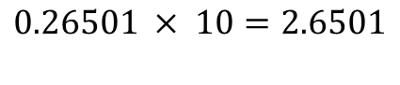
Multiply by 10?
( | 0 | . | 2 | 6 | 5 | 0 | 1 | )₁₀
$$\text{0.26501} × 10=2.6501$$
Notes:
0.26501 * 10

Slide 164
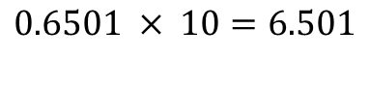
Multiply by 10?
( | 0 | . | 2 | 6 | 5 | 0 | 1 | )₁₀
$$\text{0.6501} × 10=6.501$$
Notes:
0.26501 * 10

Slide 165
Fraction | Result | Integer Part
0.26501×10 | 2.6501 | 2
0.6501×10 | 6.501 | 6
0.501×10 | 5.01 | 5
0.01×10 | 0.1 | 0
0.1×10 | 1.0 | 1
0

Slide 166
(0.░)₁₆ ← (0.░)₁₀

Slide 167
Fraction | Result | Integer Part
0.26501×16 | 4.24016 | 4
0.24016×16 | 3.84256 | 3
0.84256×16 | 13.48096 | 13 = D
0.48096×16 | 7.69536 | 7
0.69536×16 | 11.12576 | 11 = B
0.12576×16 | 2.01216 | 2
0.01216×16 | 0.19456 | 0
0.194560006×16 | 3.11296 | 3
0.1129601×16 | 1.807362 | 1
0.807361603×16 | 12.91779 | 12 = C
0.917785645×16 | 14.68457 | 14 = E
0.684570313×16 | 10.95313 | 10 = A
0.953125×16 | 15.25 | 15 = F
0.25×16 | 4 | 4
0 | 0 | 0
(0.26501)₁₀ → (0.43D7B2031CEAF40)₁₆
Notes:
43 13 7 11 2031 12 14 10 15 40

Slide 168
(0.░)₈ ← (0.░)₁₀
(0.░)₄ ← (0.░)₁₀
(0.░)₂ ← (0.░)₁₀
_{Microsoft excel sheet}

Slide 169
(░.░)_{r} (░.░)_{r’}
→
→
(░.░)₁₀
Integer Part independent of Fraction Part!

Slide 170
(░ .)_{r} (░ .)_{r’}
→
→
(░ .)₁₀
Integer Part

Slide 171
(. ░)_{r} (. ░)_{r’}
→
→
(. ░)₁₀
Fraction Part

Slide 172
(30,302,131. 26501)₁₀ | (163457663.20753….)₈
Quotient | Remainder
30,302,131÷8 | 3
3787766÷8 | 6
473470÷8 | 6
59183÷8 | 7
7397÷8 | 5
924÷8 | 4
115÷8 | 3
14÷8 | 6
1÷8 | 1
0
Fraction | Result | Integer Part
0.26501×8 | 2.12008 | 2
0.12008×8 | 0.96064 | 0
0.96064×8 | 7.68512 | 7
0.68512×8 | 5.48096 | 5
0.48096×8 | 3.84768 | 3
0.84768×8 | 6.78144 | 6
0.78144×8 | 6.25152 | 6
0.25152×8 | 2.01216 | 2
0.01216×8 | 0.09728 | 0
… | … | …

Slide 173
Base-2 → Base-[2², 2³, 2⁴, 2^{n}]
_{Lecture assignment}

Slide 174
Base-2 ← Base-[2², 2³, 2⁴, 2^{n}]
_{Lecture assignment}

Slide 175
https://planetcalc.com/862/

Slide 176
arithmetic

